Slide 1

Publicly Available Data & Data Integration
Lauren Vanderlinden, PhD, MS
T15 Postdoctoral Fellow Computational Biology
Division of Rheumatology & Department of Biomedical Informatics
School of Medicine, University of Colorado Anschutz Medical Campus
CPBS 7602 - December 11, 2024

Slide 2
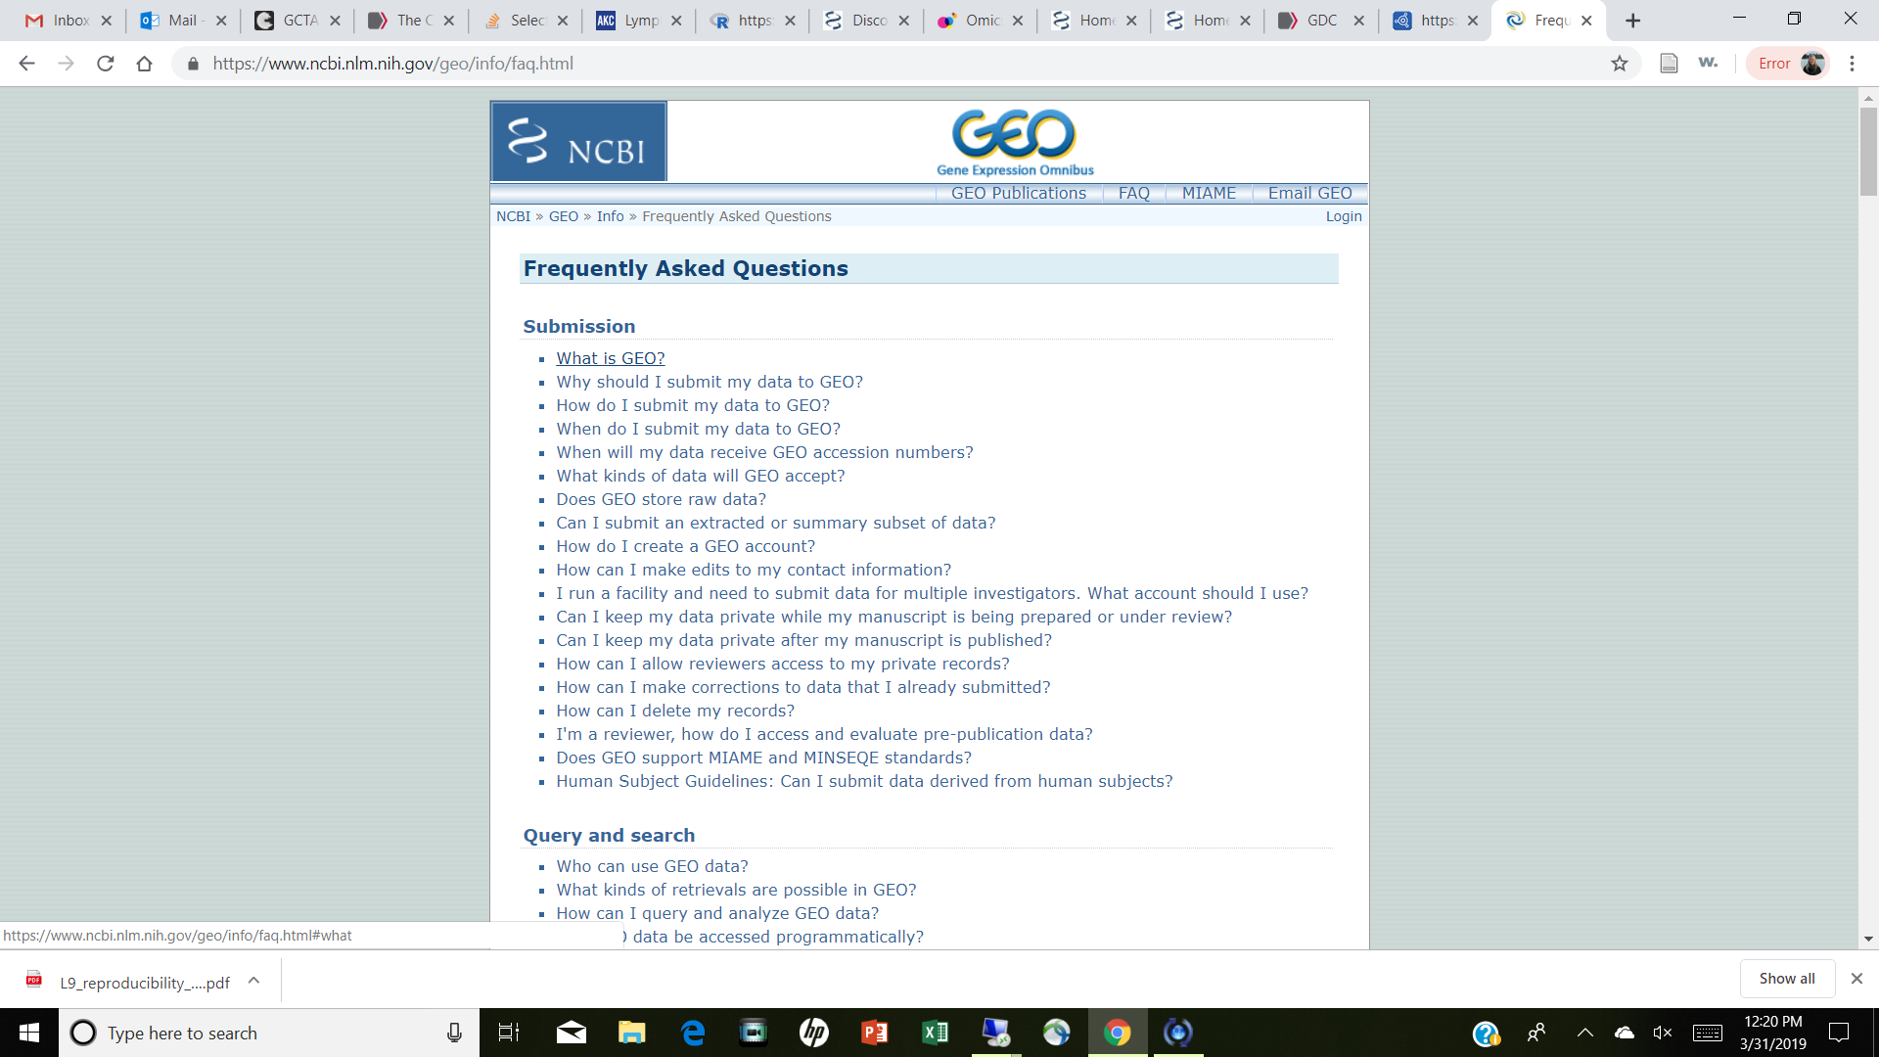
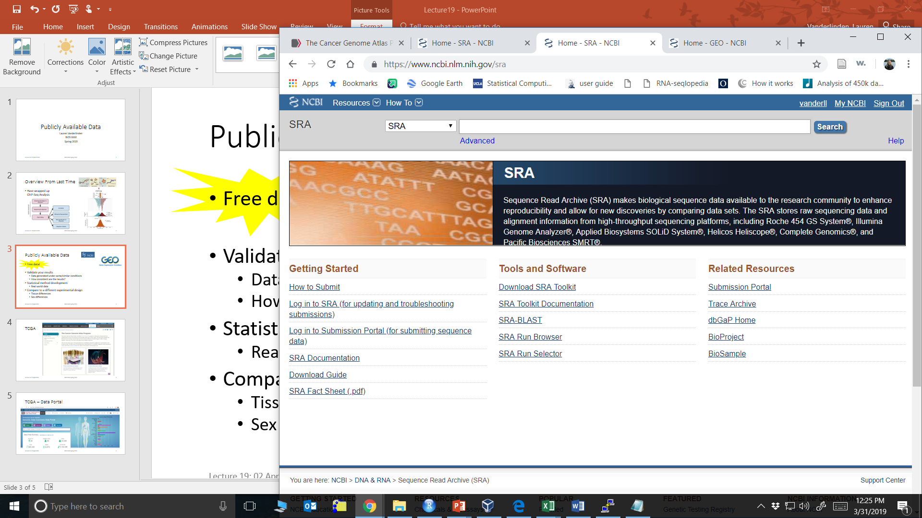



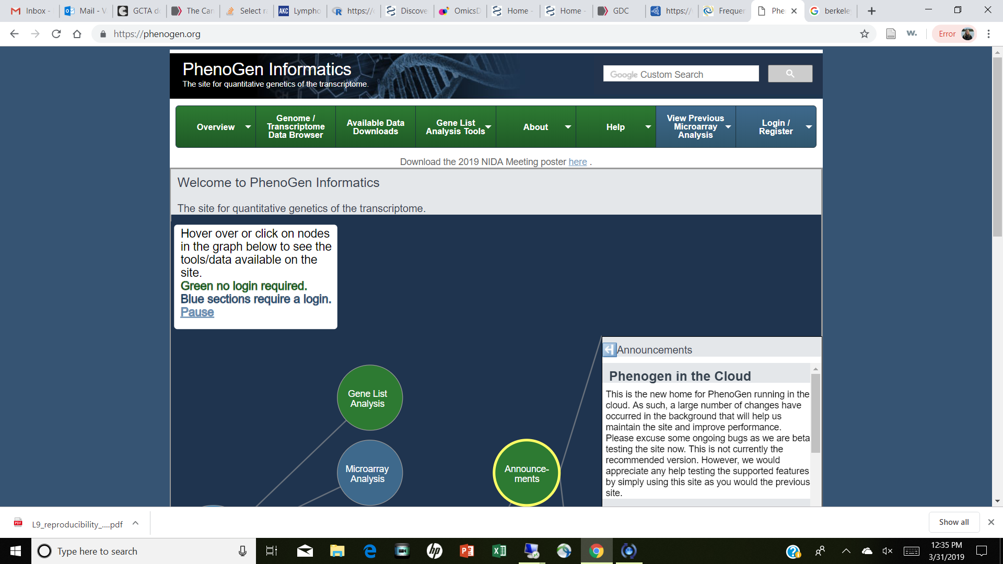
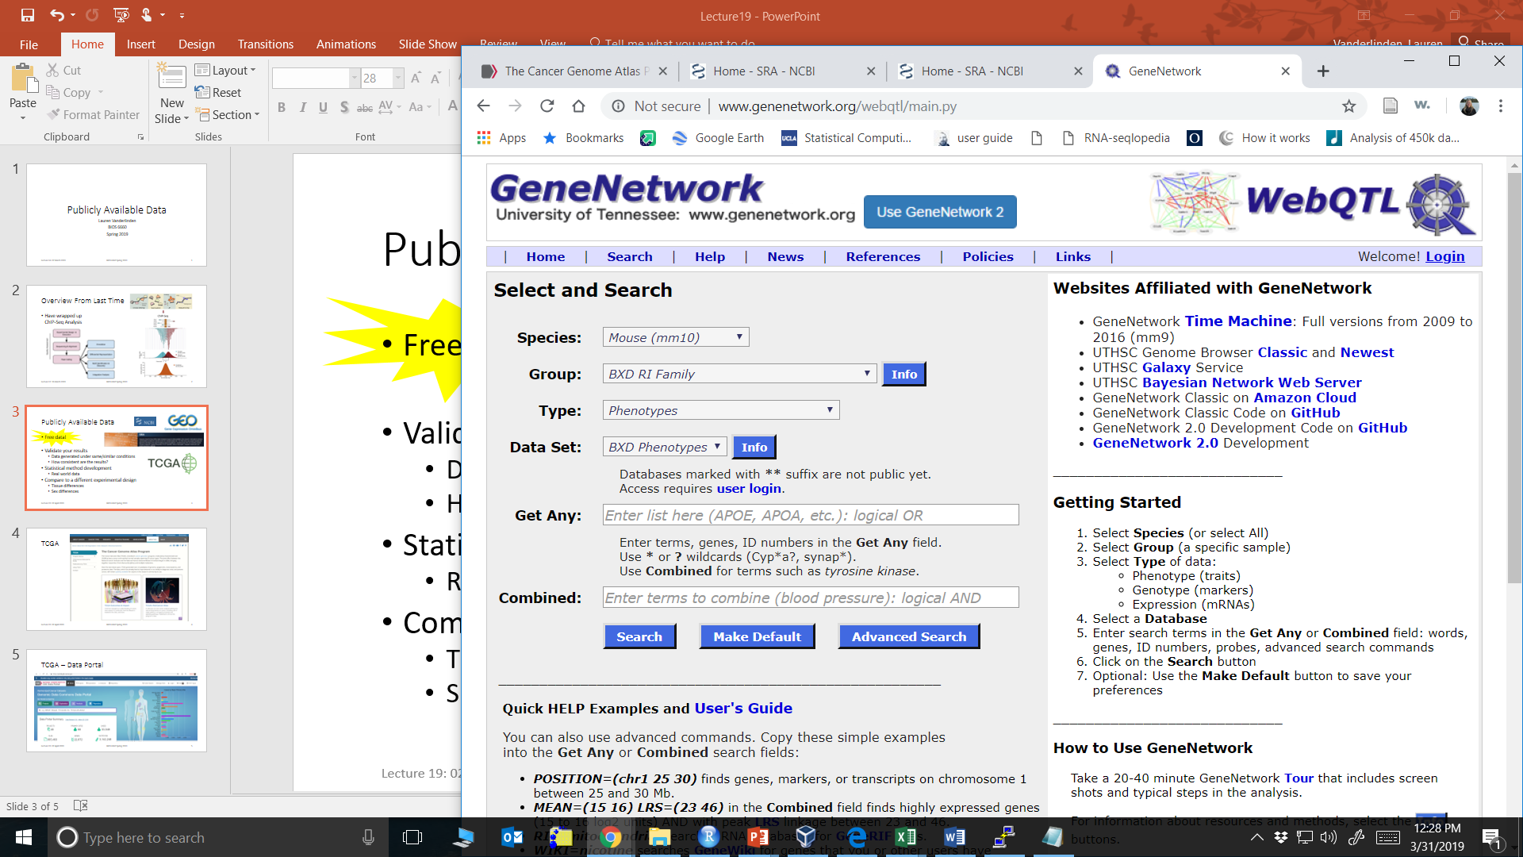
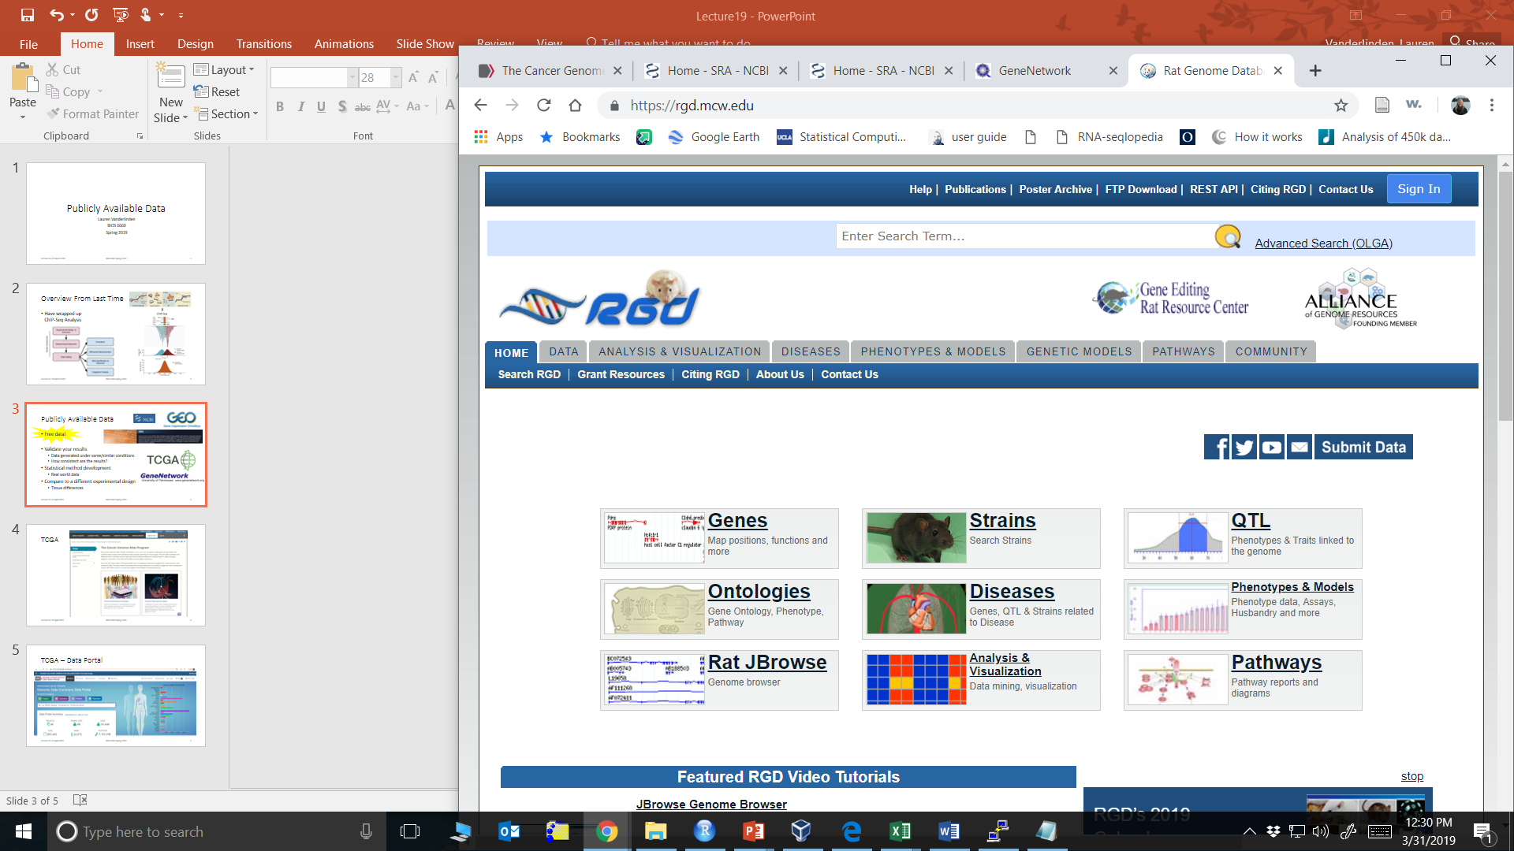
Publicly Available Data
Free data!
Validate your results
Data generated under same/similar conditions
How consistent are the results?
Statistical method development
Real world data
Compare to a different experimental design
Tissue differences
Students: always have data

Slide 3
Human Repositories

Slide 4
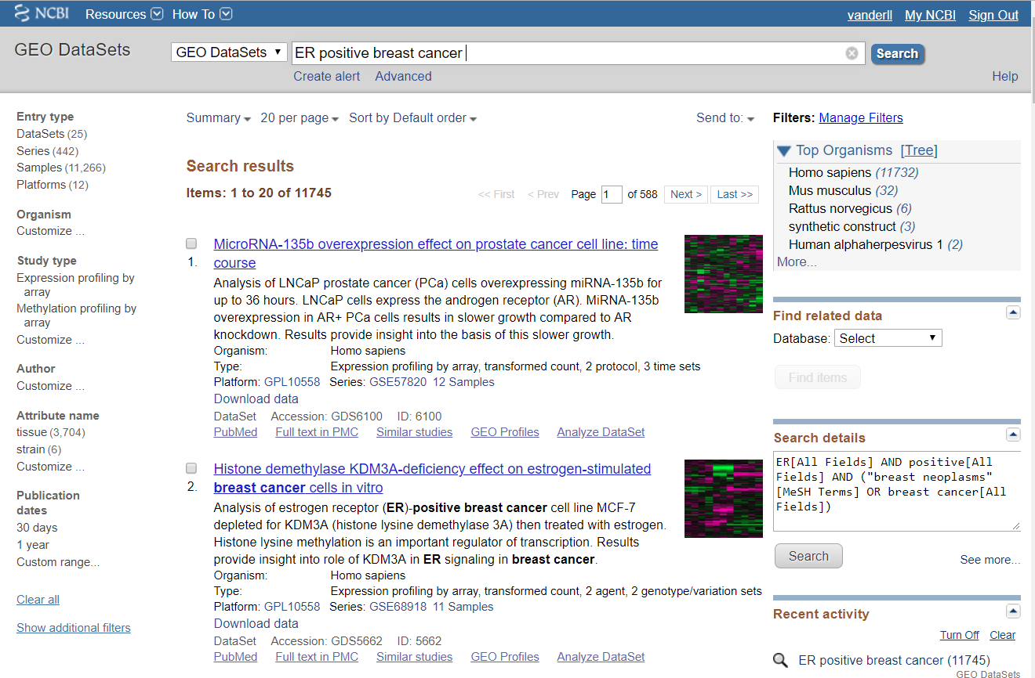
GEO Database
https://www.ncbi.nlm.nih.gov/geo/
NCBI Gene Expression Omnibus
Microarray database
mRNA arrays
Methylation arrays
SNP arrays
miRNA arrays
Query like a literature search

Slide 5
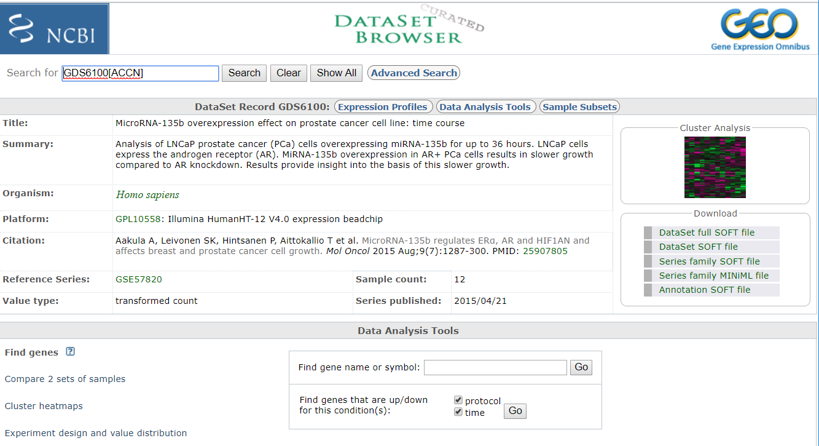
GEO Datasets – Selected Title
GSM: Sample level
GDS: Dataset
GSE: Series
GPL: Platform

Slide 6
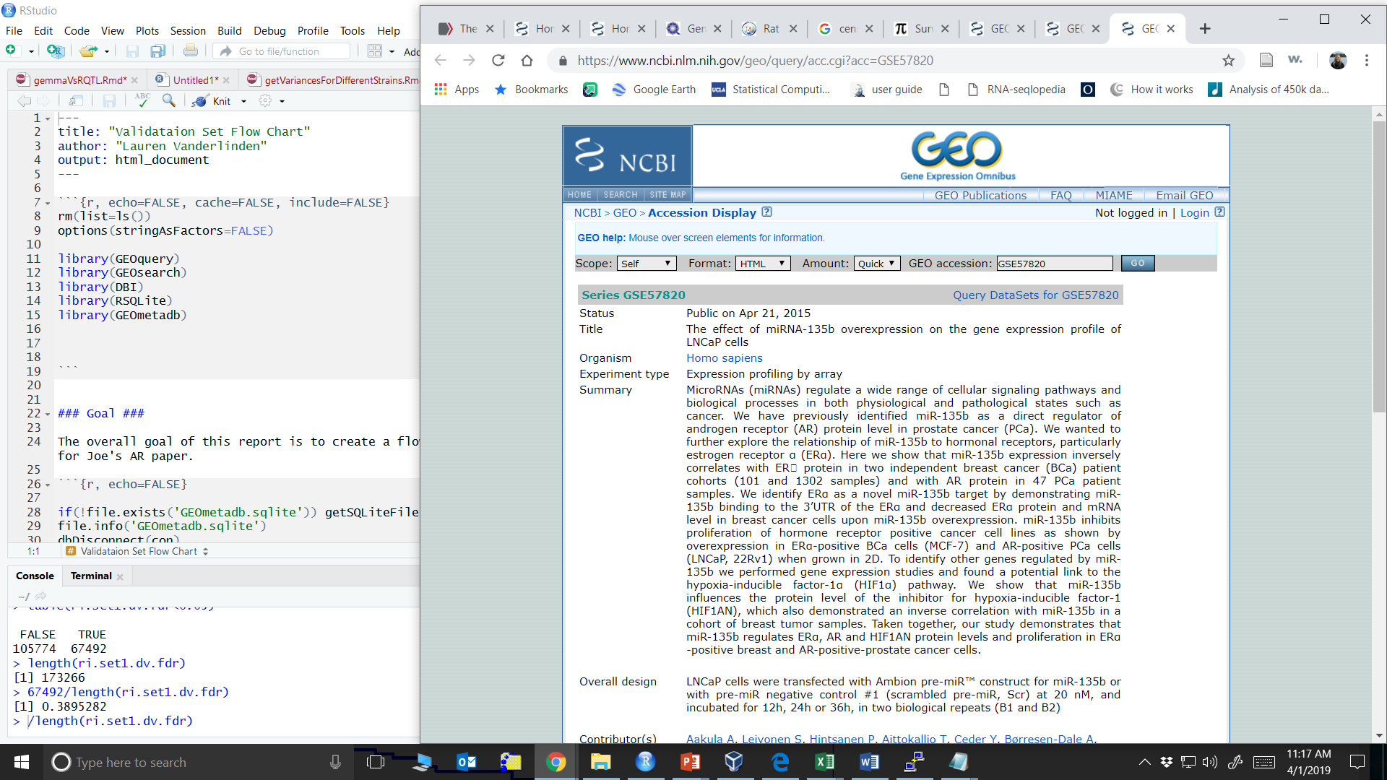
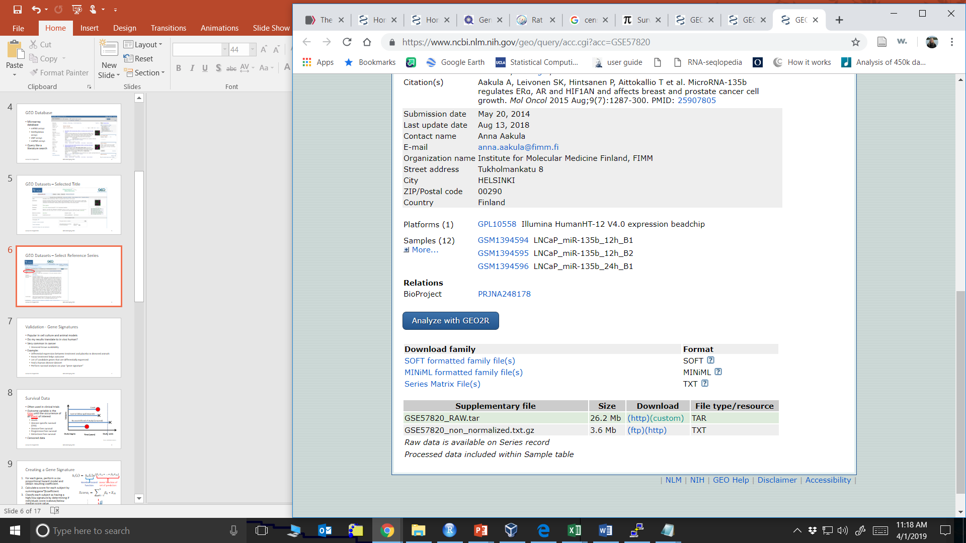
GEO Datasets – Select Reference Series
SOFT: Simple Omnibus Format in Text
Has both array data and meta data

Slide 7
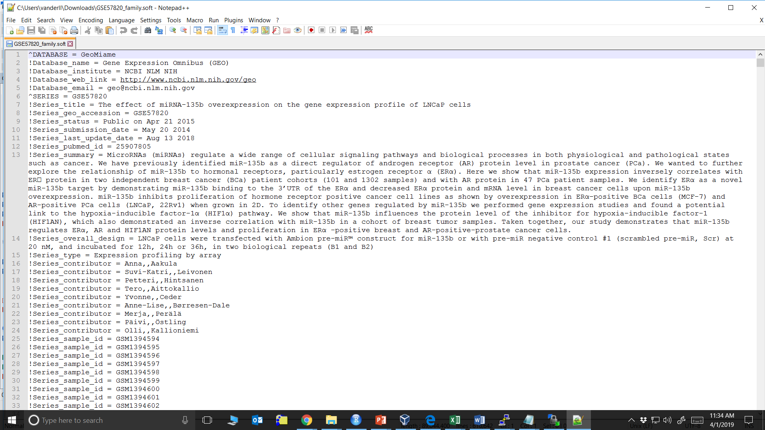
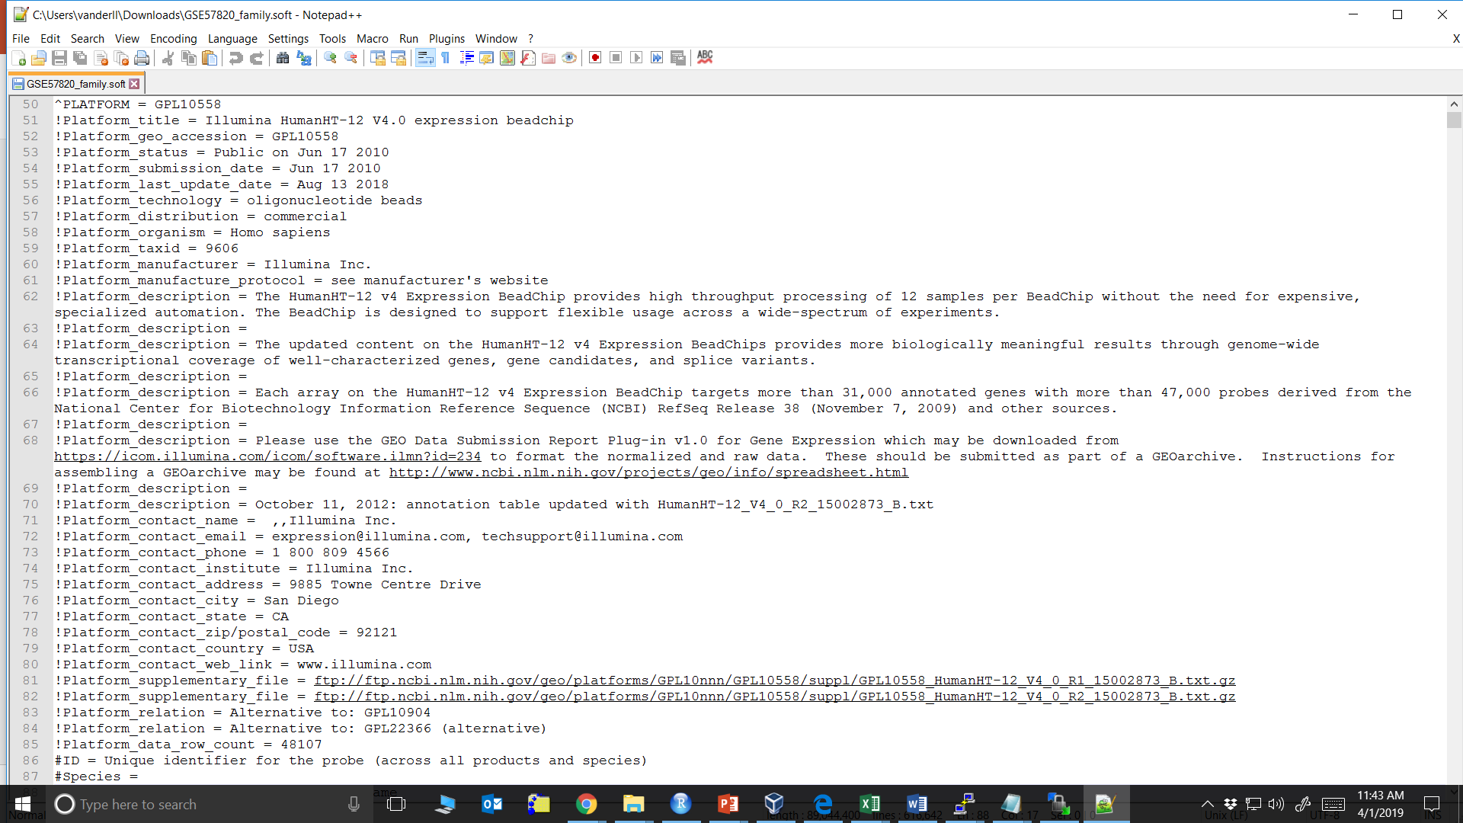
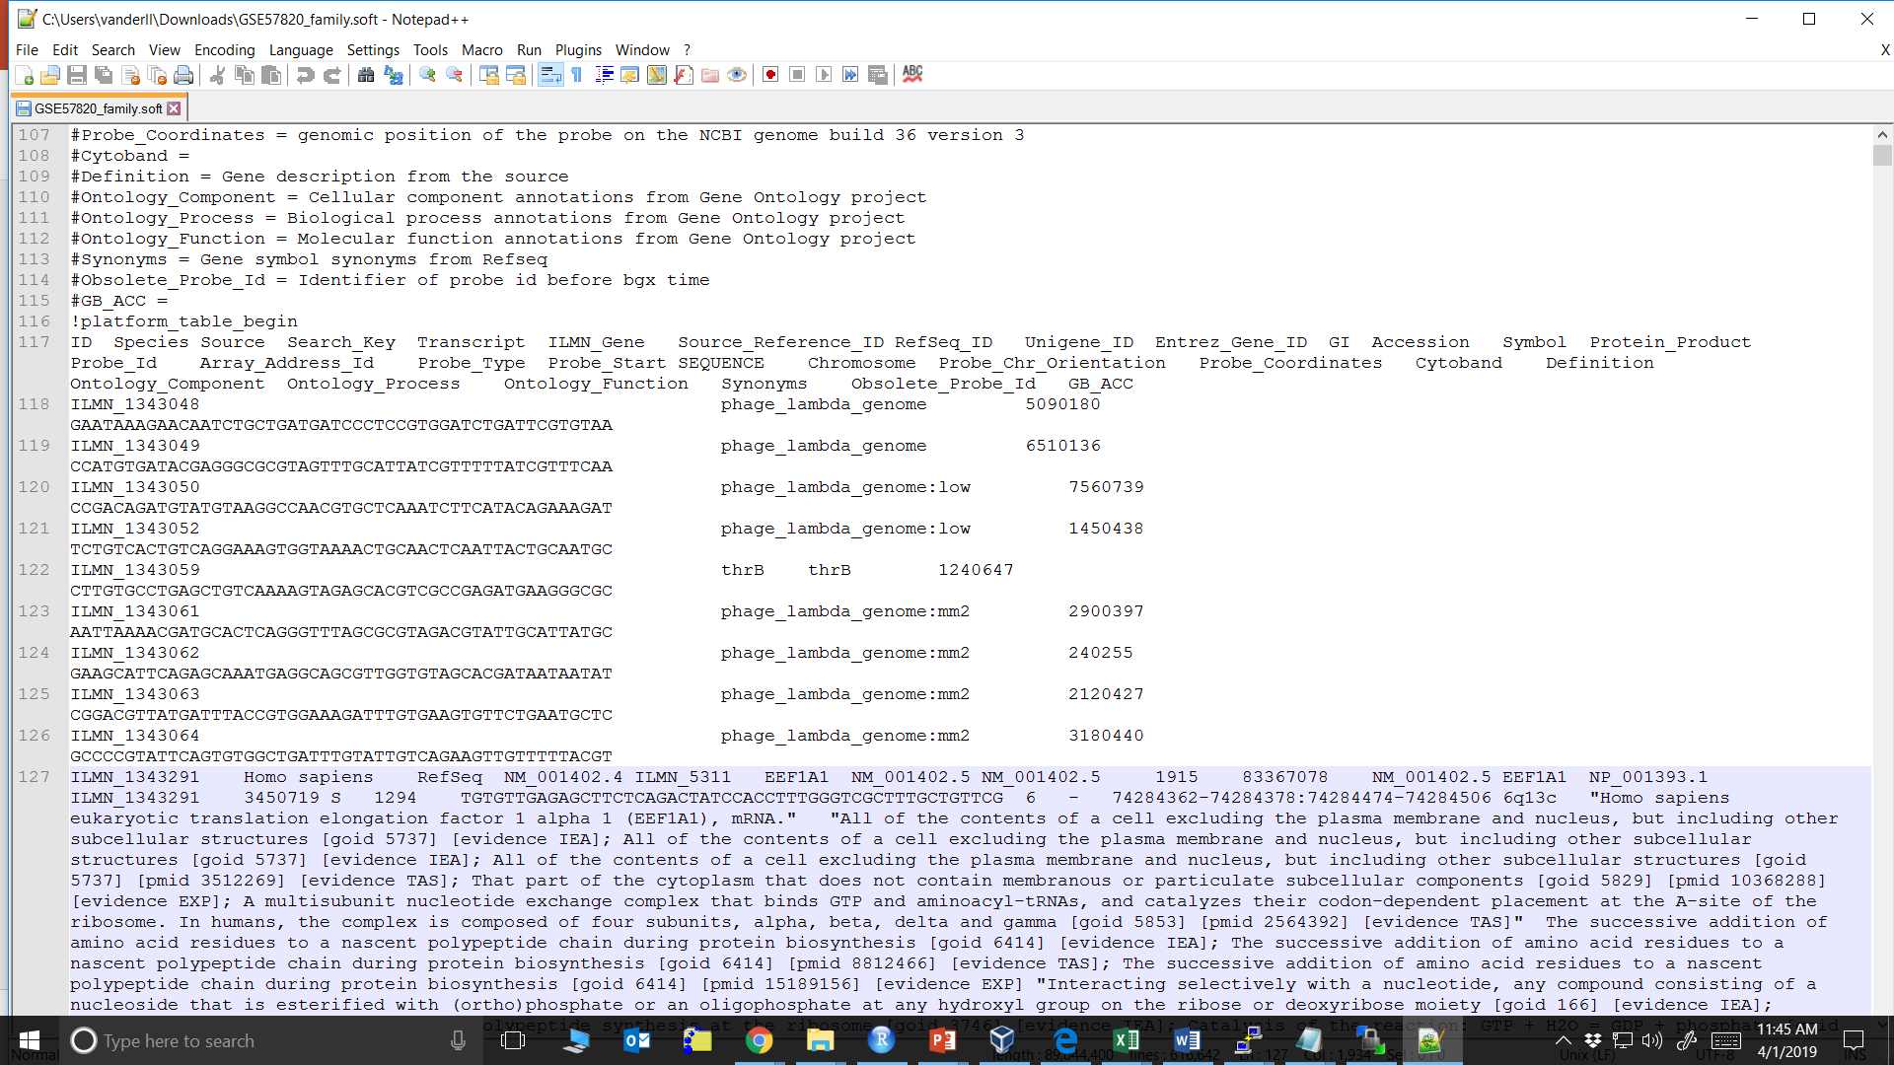
SOFT Dataset

Slide 8
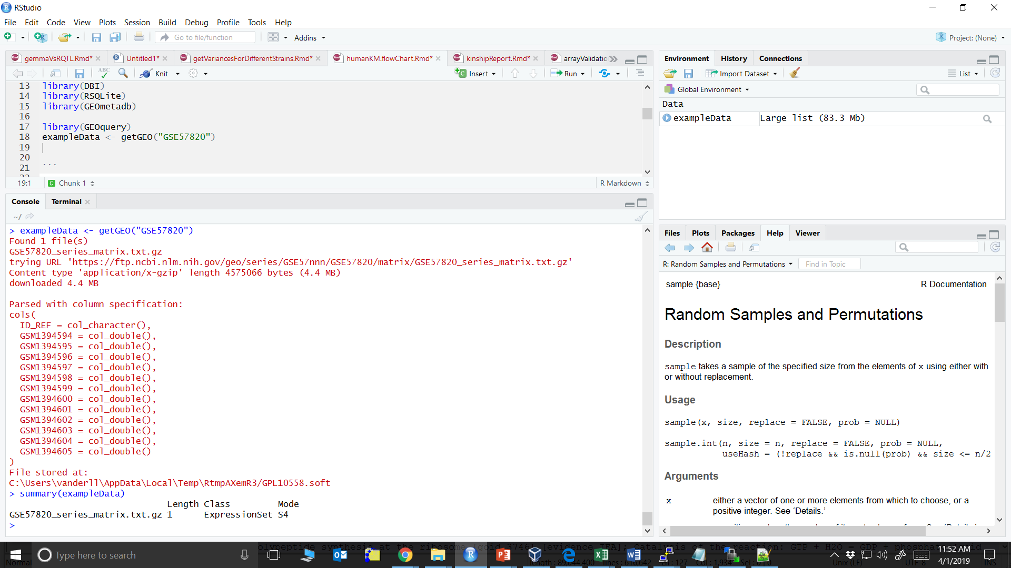
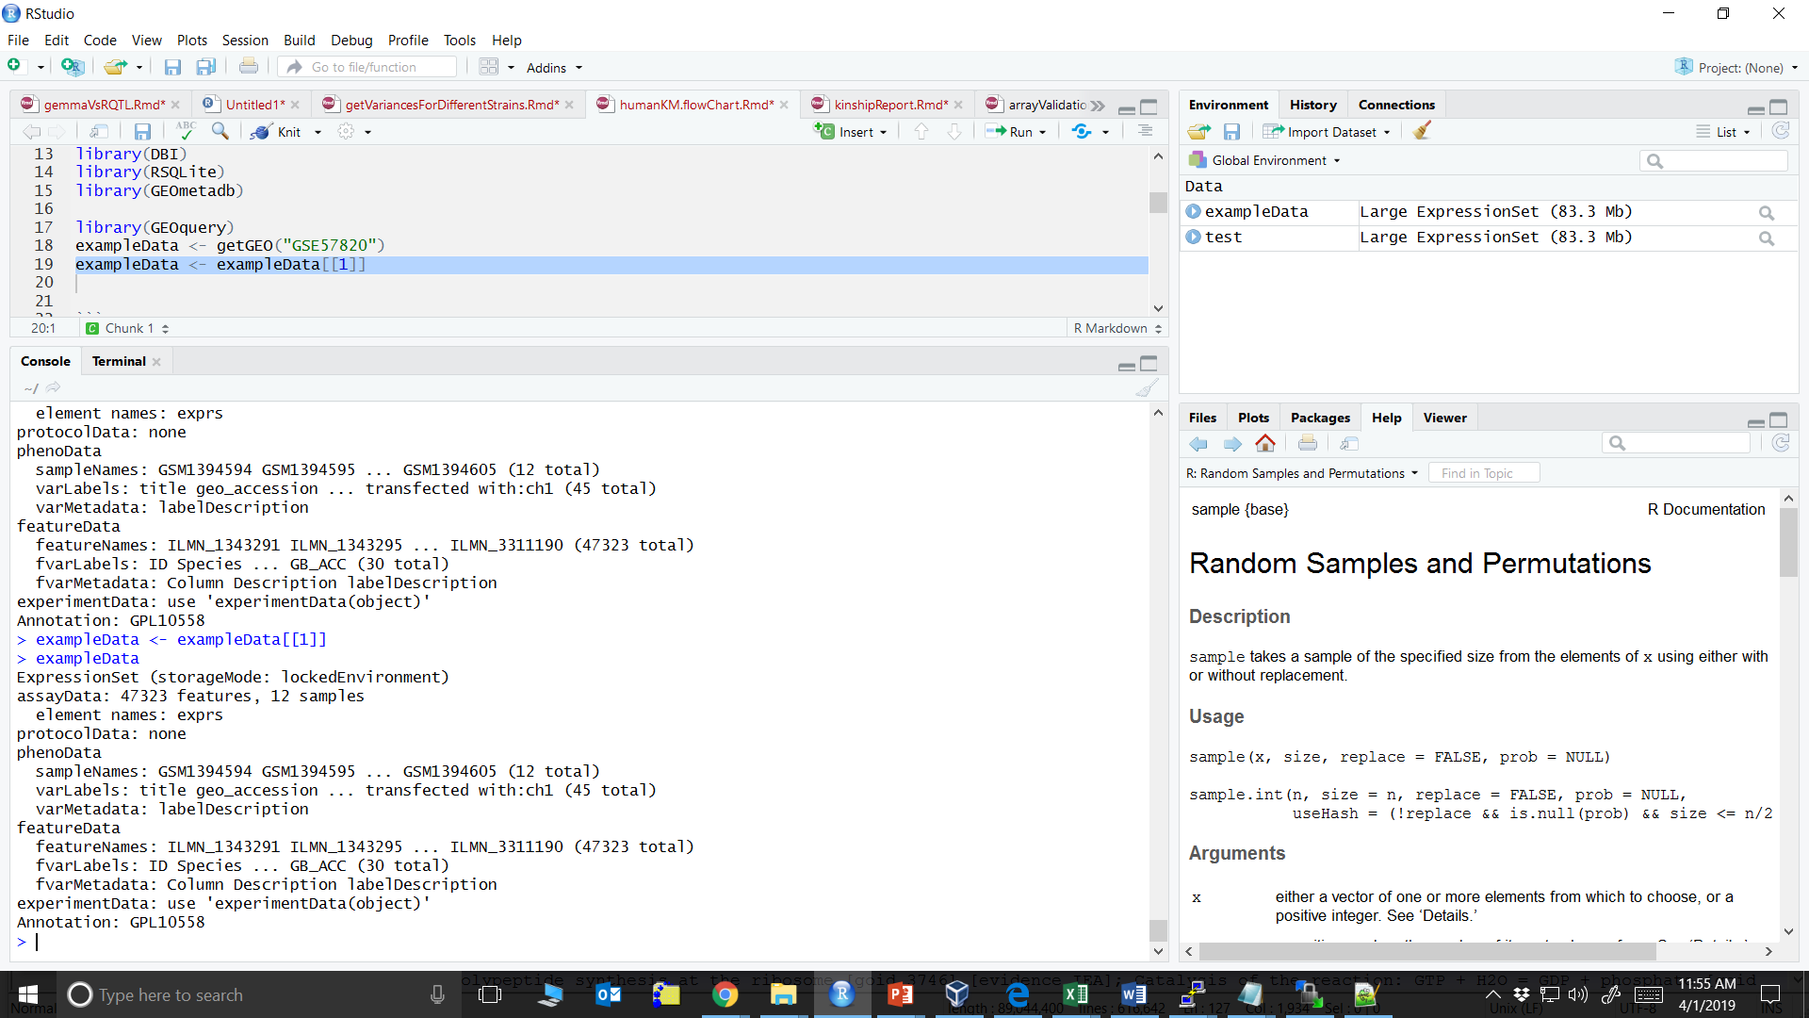
R/GEOquery
library(GEOquery)
exampleData <- getGEO(“/path/file.soft.gz”)

Slide 9
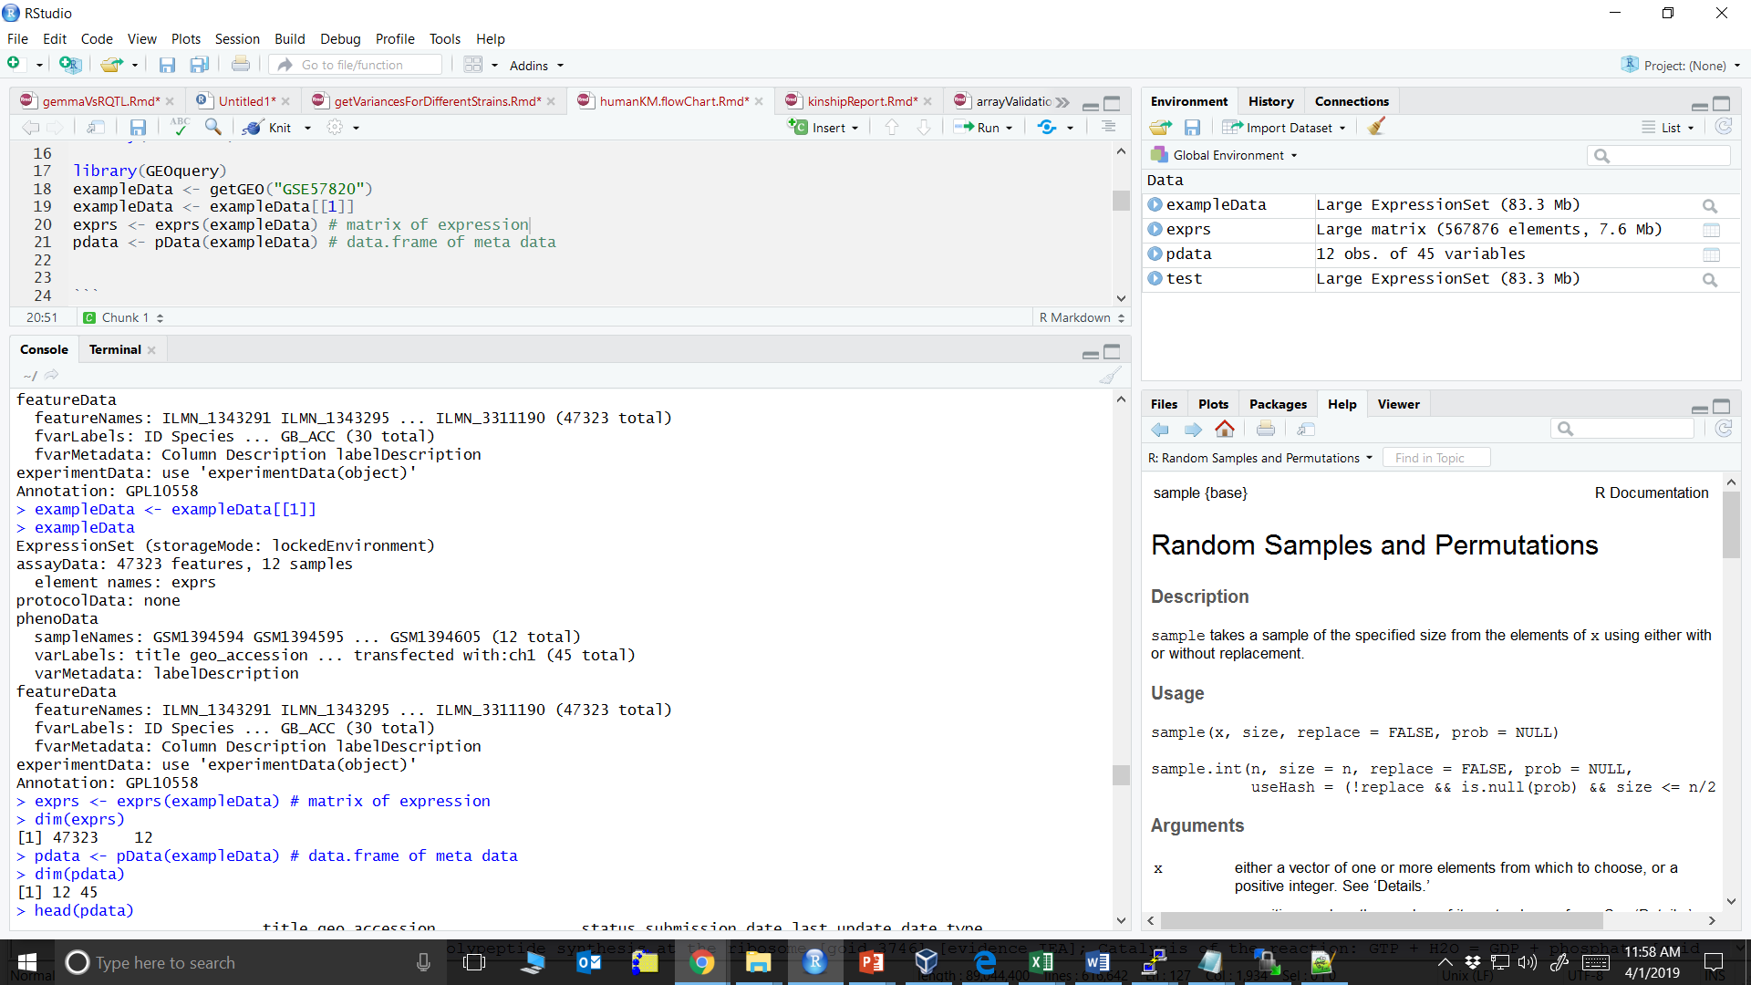
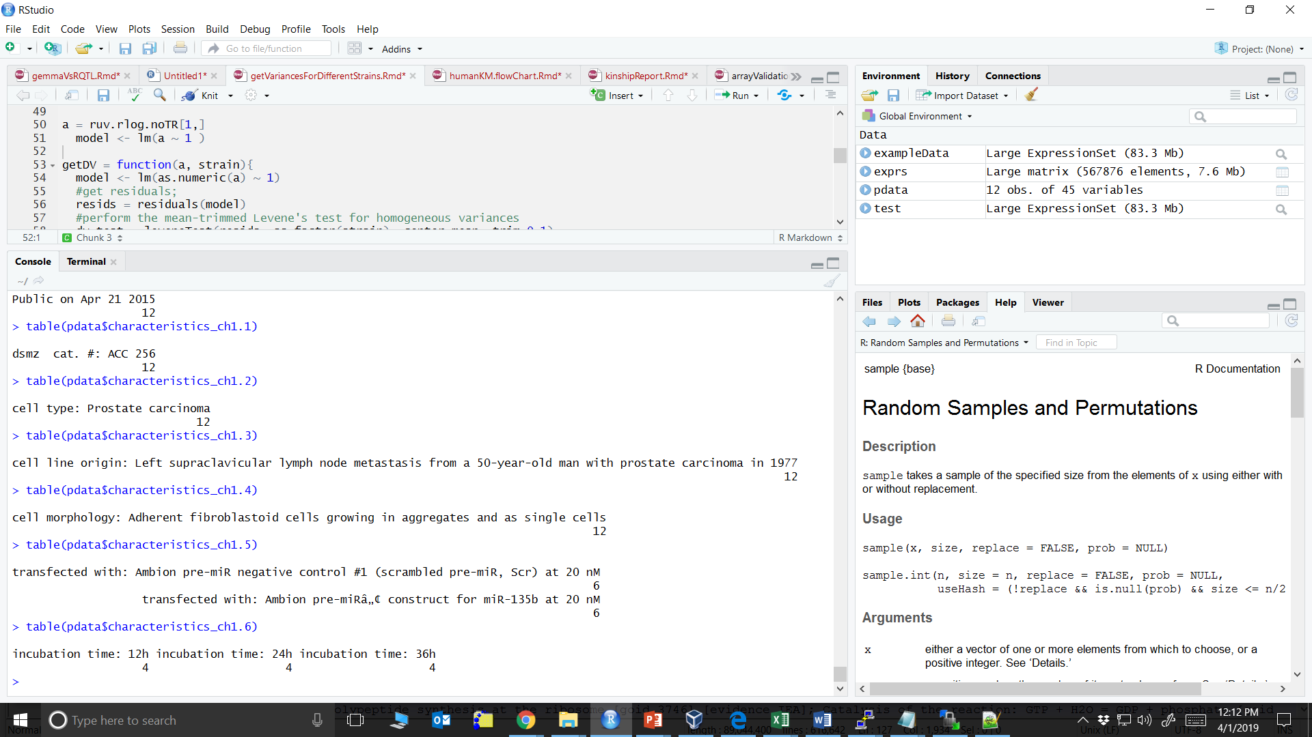
R/GEOquery
47,323 probe sets & 12 samples
45 phenotypes for 12 samples
You can use this data moving forward
CHECK: with the array data you won’t have missing data, but you may have a lot with phenotype data
Names are super detailed and redundant, may want to change before analyses

Slide 10
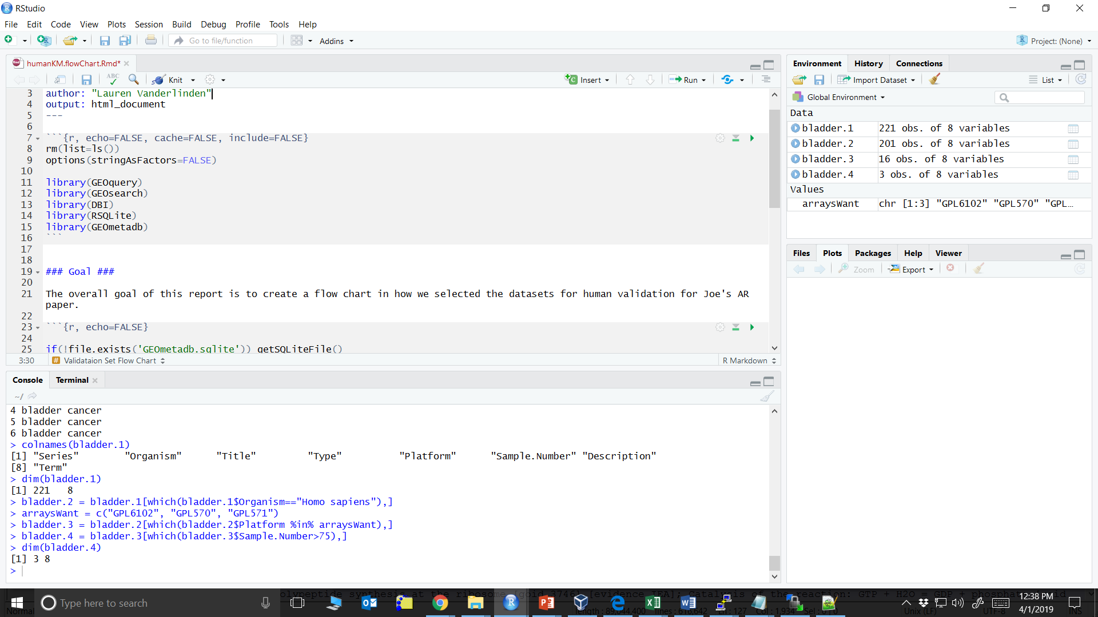
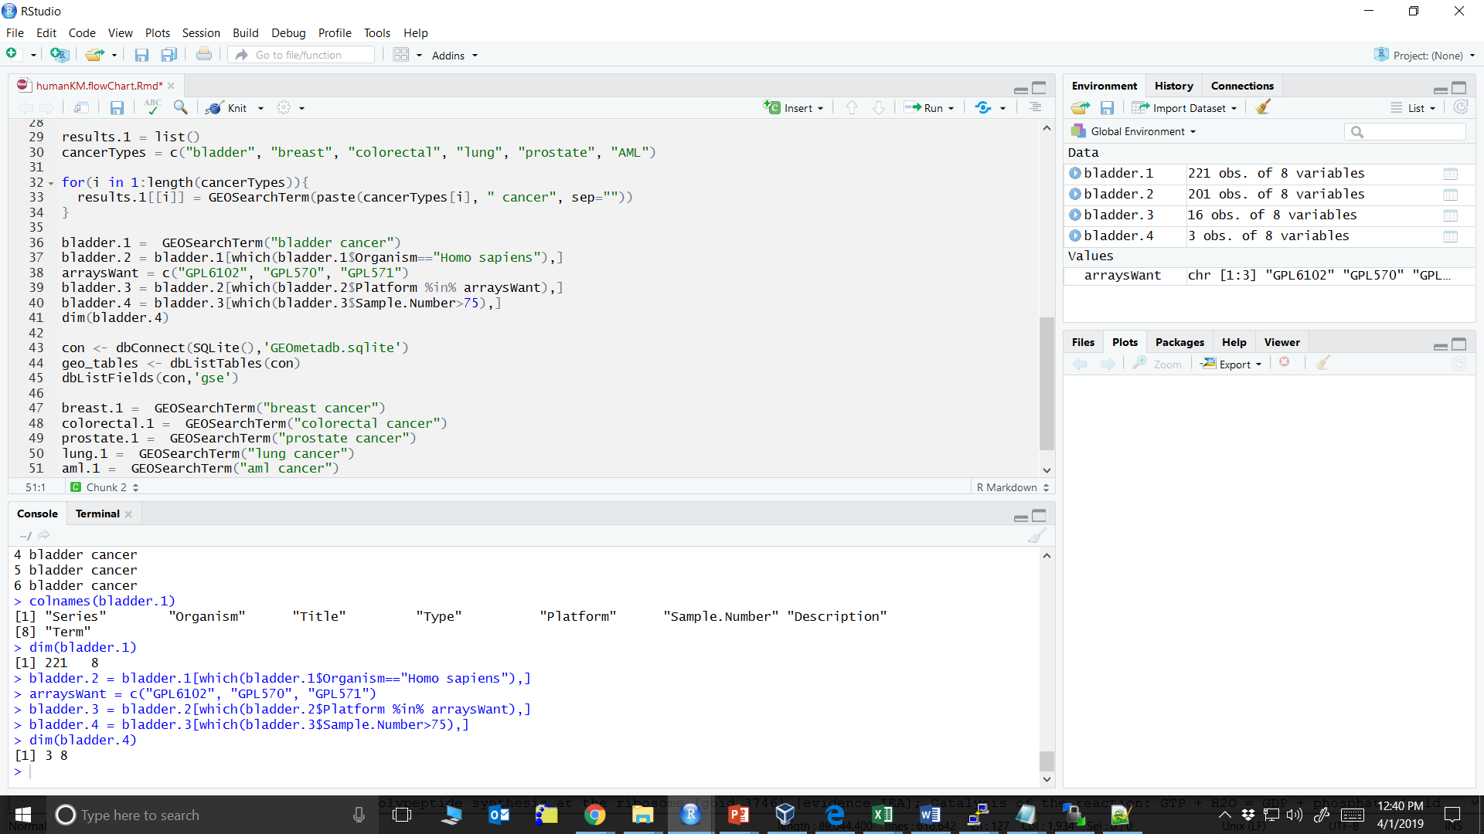
Browsing GEO in R
1. Search “bladder cancer”
3. Only specific array platforms
4. Must have >75 samples
2. Limit to humans
Example Search/Filtering Criteria

Slide 11
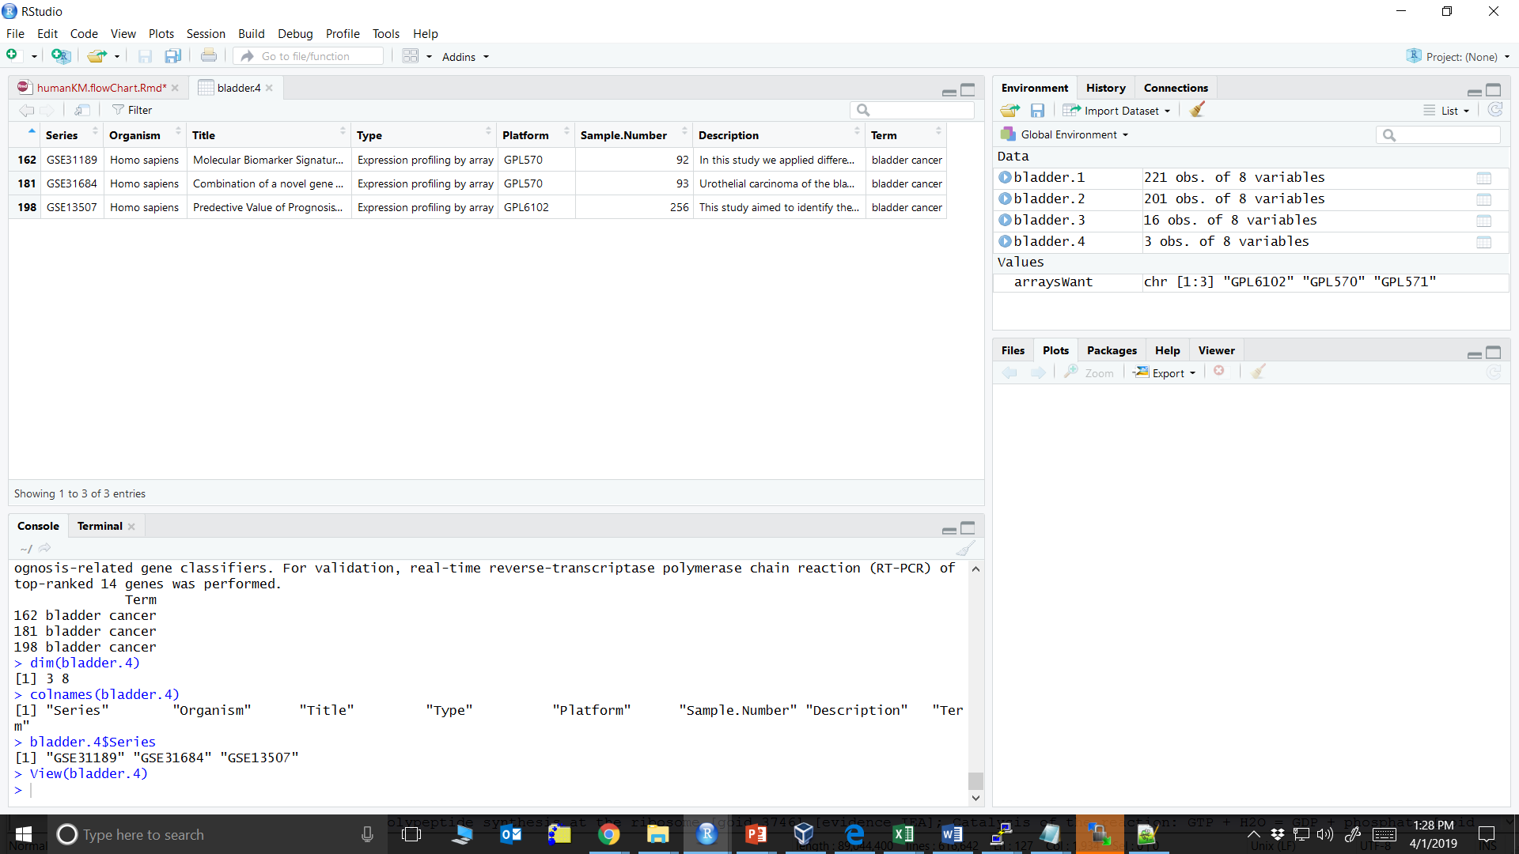
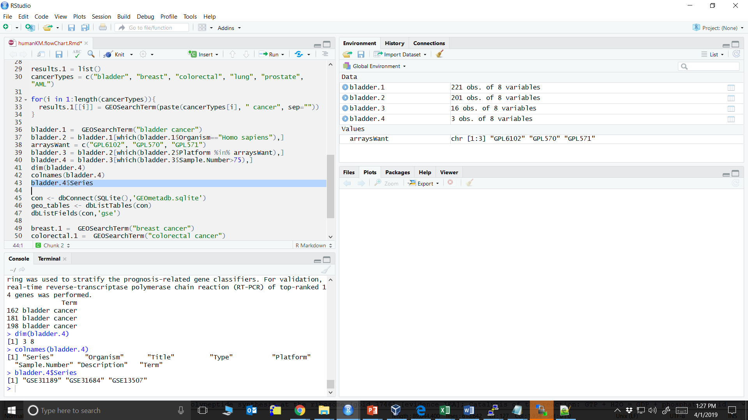
Browsing GEO in R
Once you identify the GEO datasets you want, use getGEO() for analyses

Slide 12
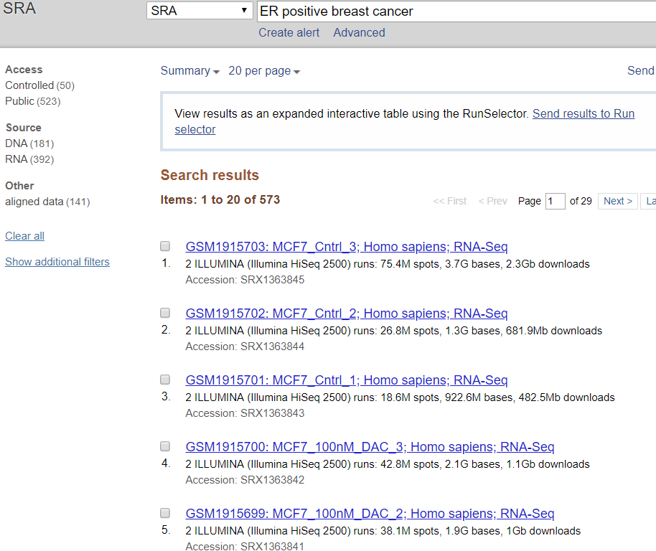
SRA Database
www.ncbi.nlm.nih.gov/sra/
NCBI Sequence Read Archive
Very similar to GEO except this is all sequencing data
RNA-Seq
DNA-Seq
ChIP-Seq
Notice initial search gives sample results

Slide 13
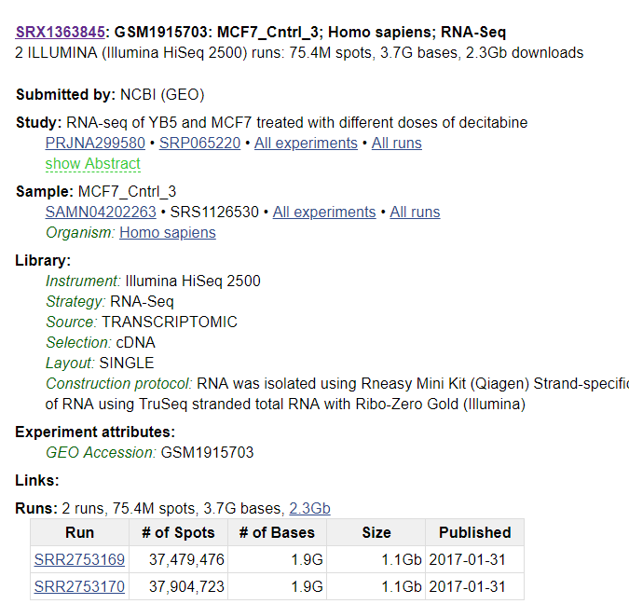
SRA Database
SRR: Individual run in the experiment
SRS: sample information
SRX: experiment level
SRP: project level
Many still linked to GEO

Slide 14
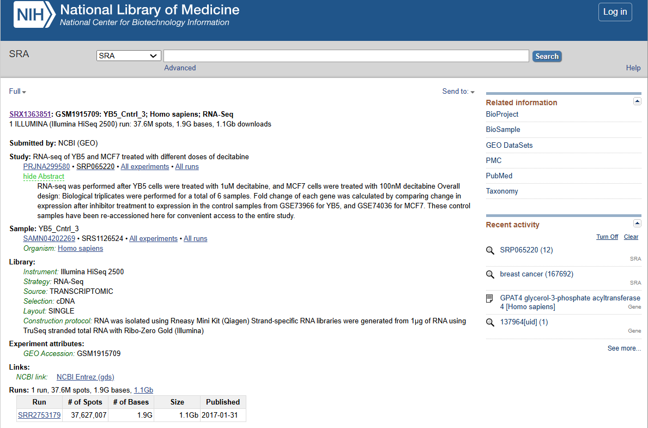
SRA Database

Slide 15
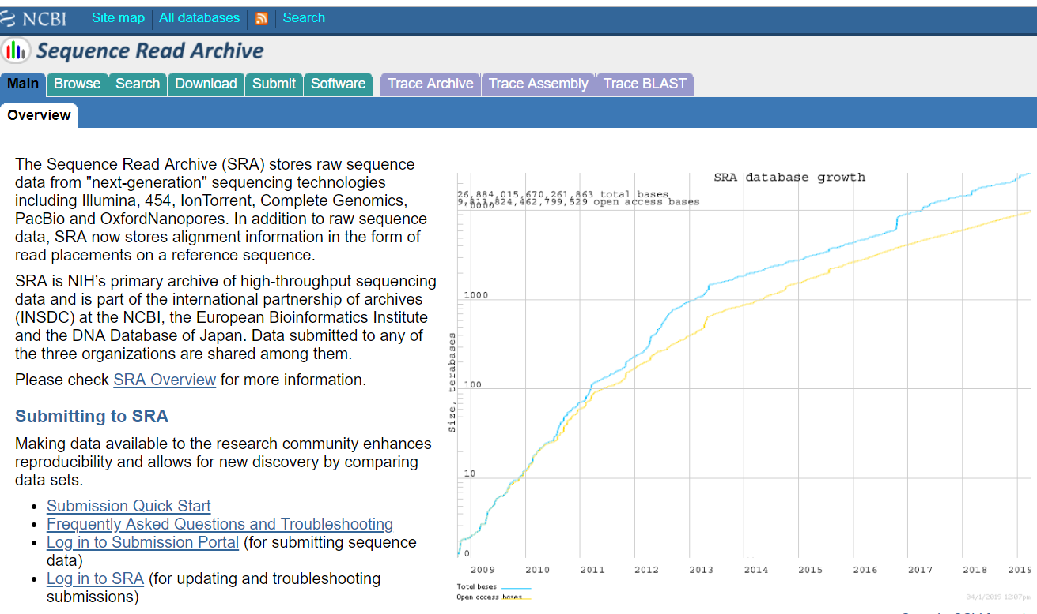

Slide 16
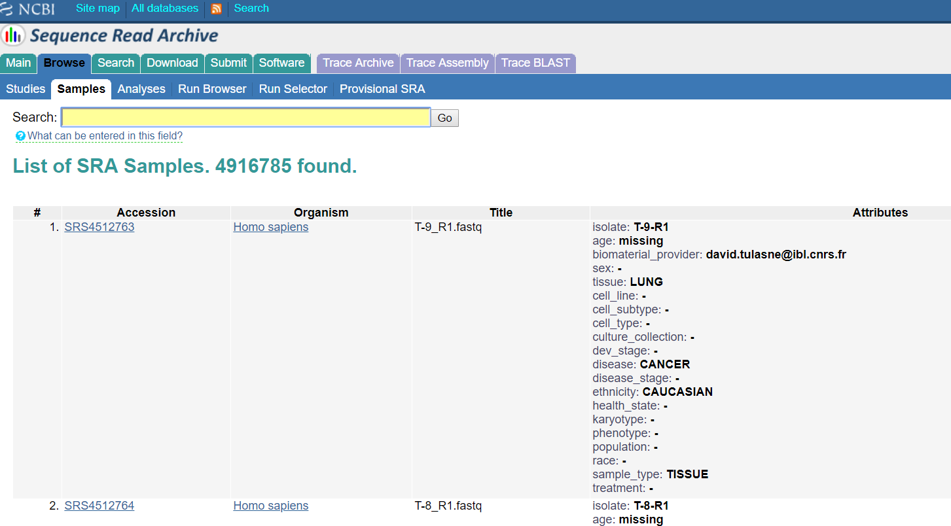

Slide 17
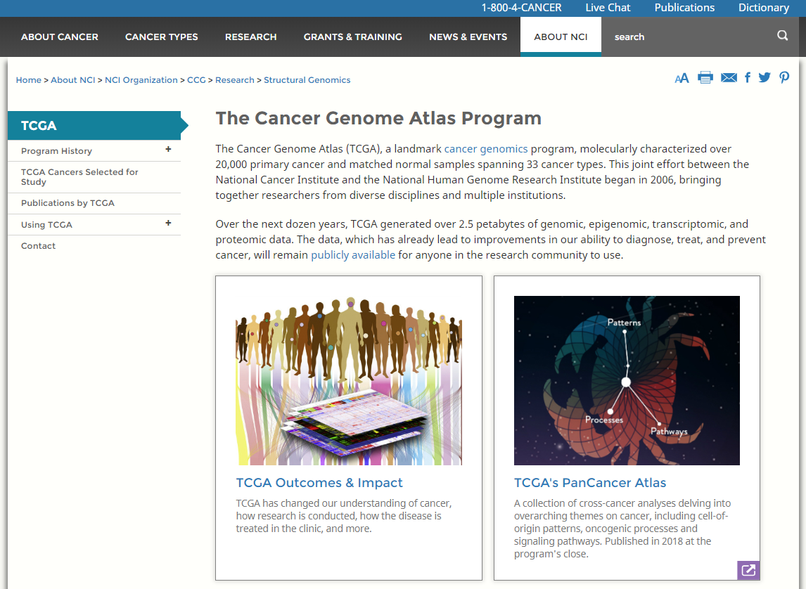
TCGA

Slide 18
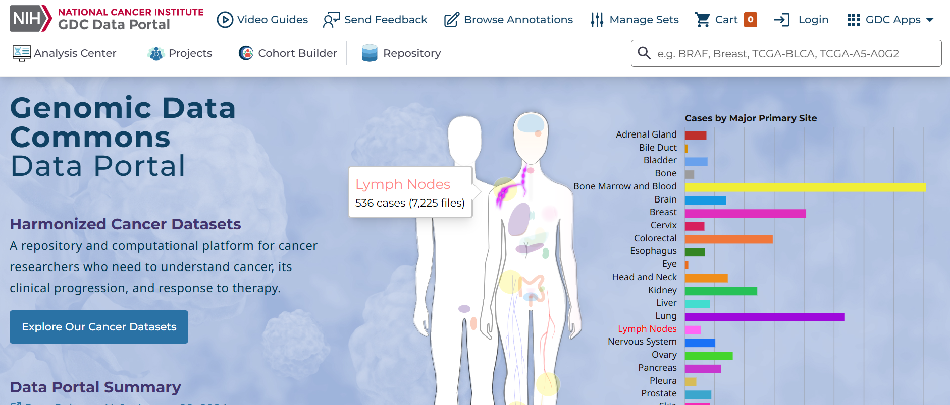
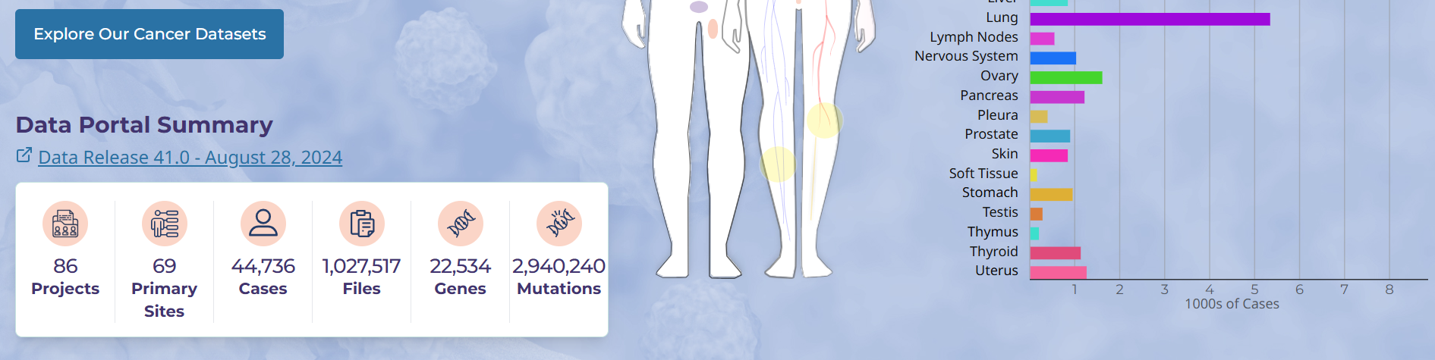
TCGA – Data Portal
https://portal.gdc.cancer.gov/

Slide 19
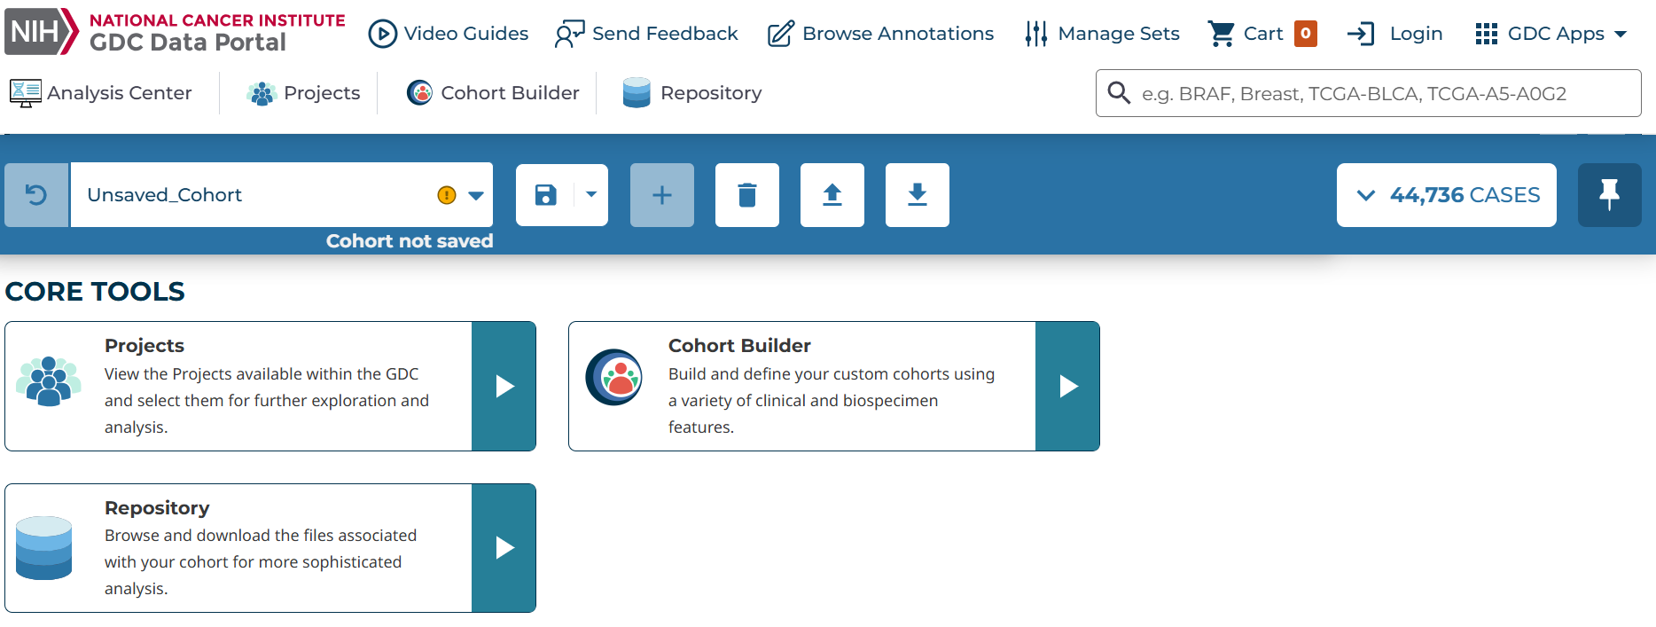
Click on Repository

Slide 20
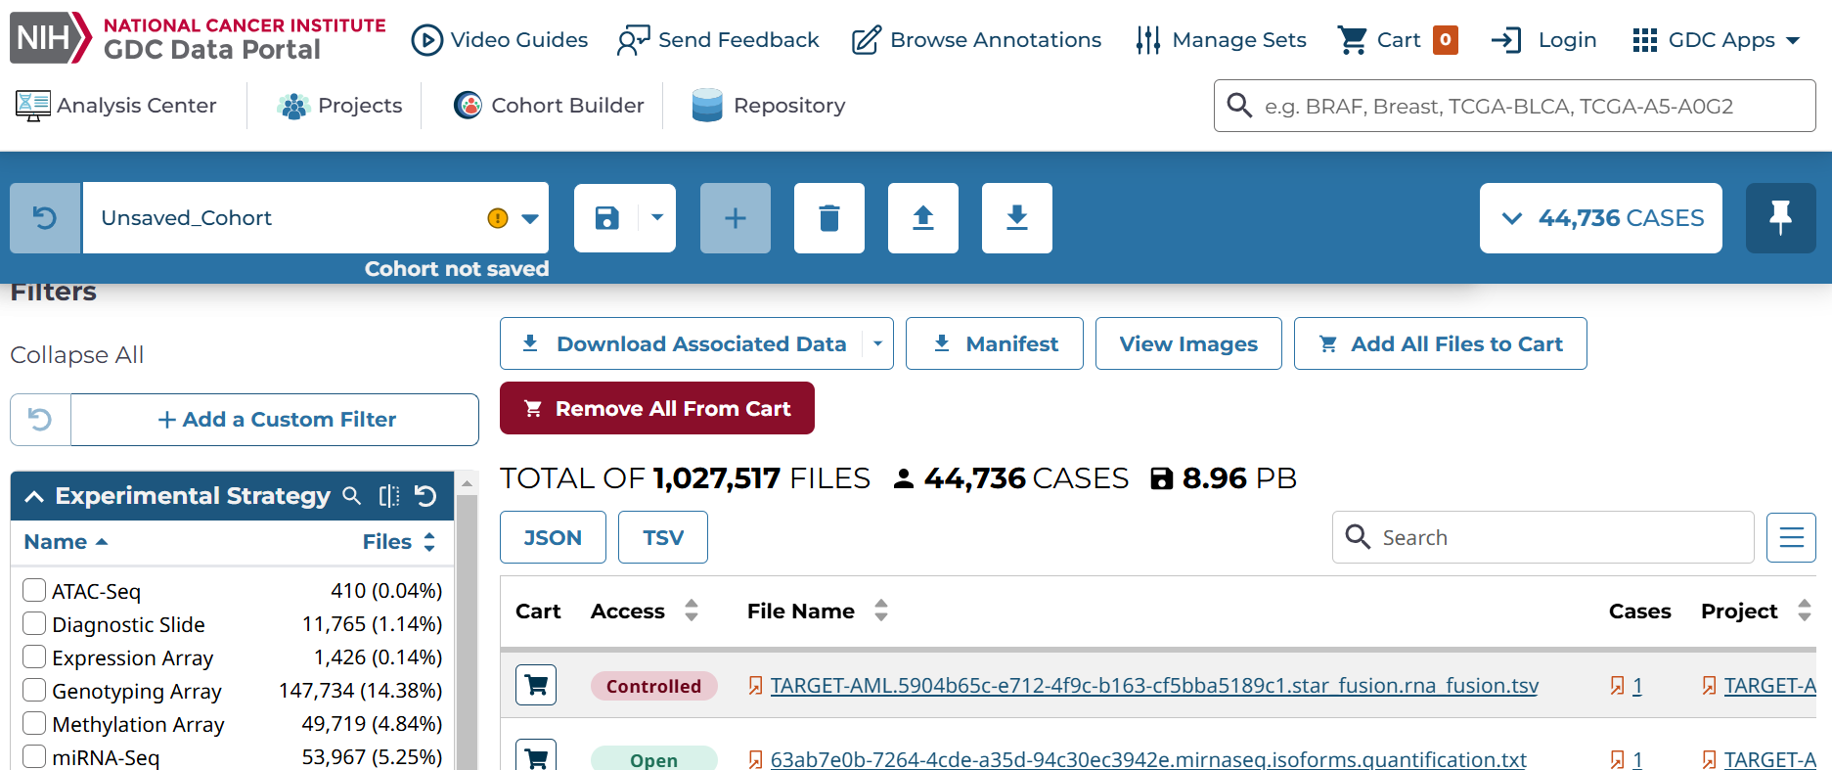
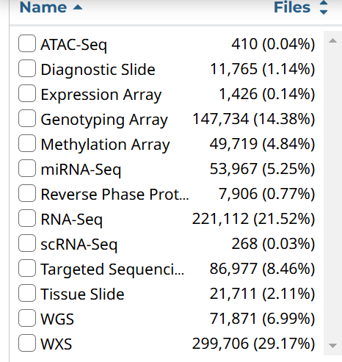

Slide 21
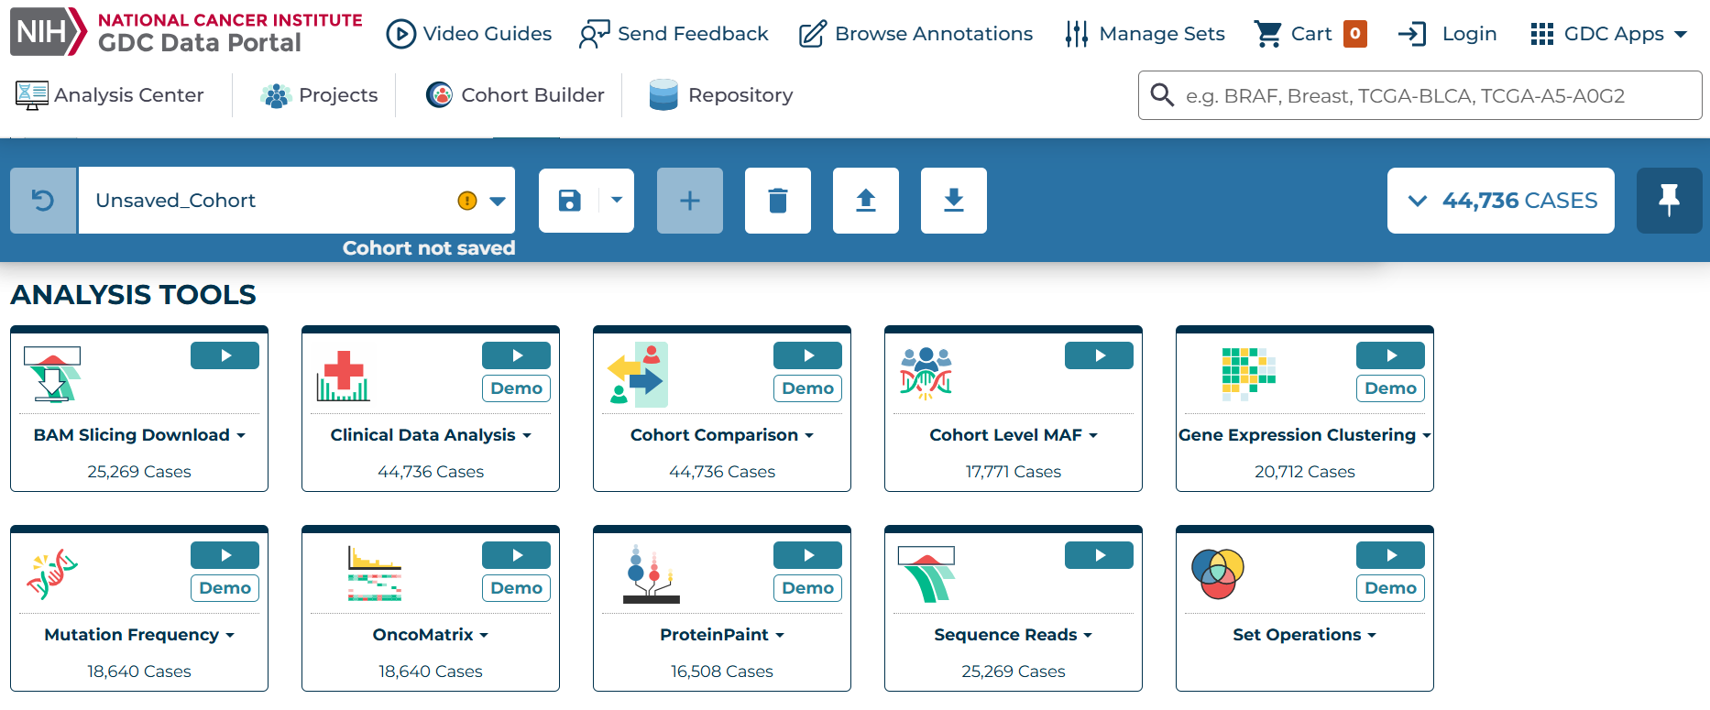

Slide 22
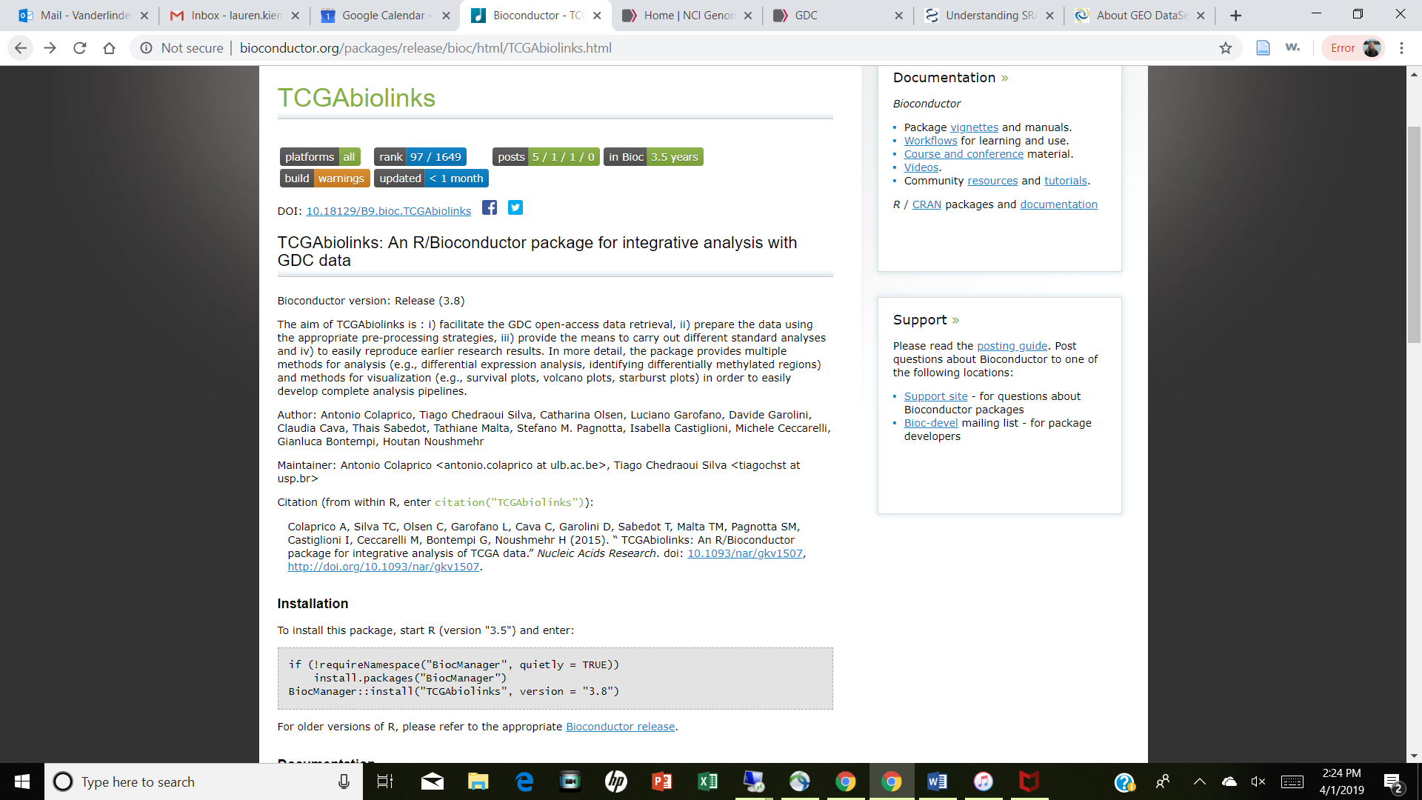
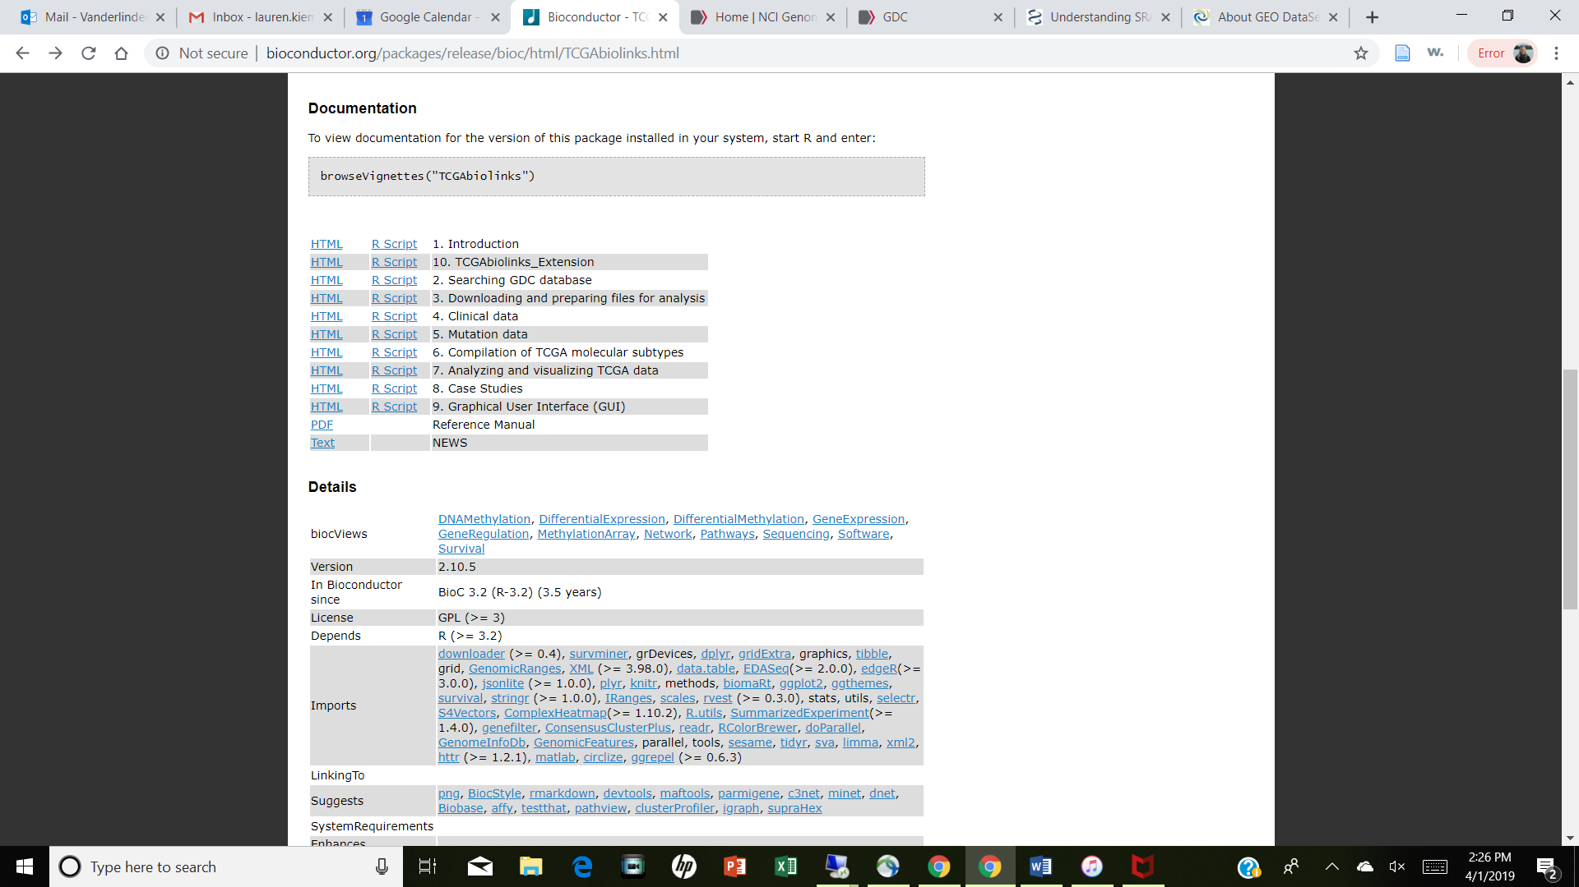
R/TCGAbiolinks
Naming system:
Aliquot barcode: TCGA-G4-6317-02A-11D-2064-05
Participant: TCGA-G4-6317
Sample: TCGA-G4-6317-02

Slide 23
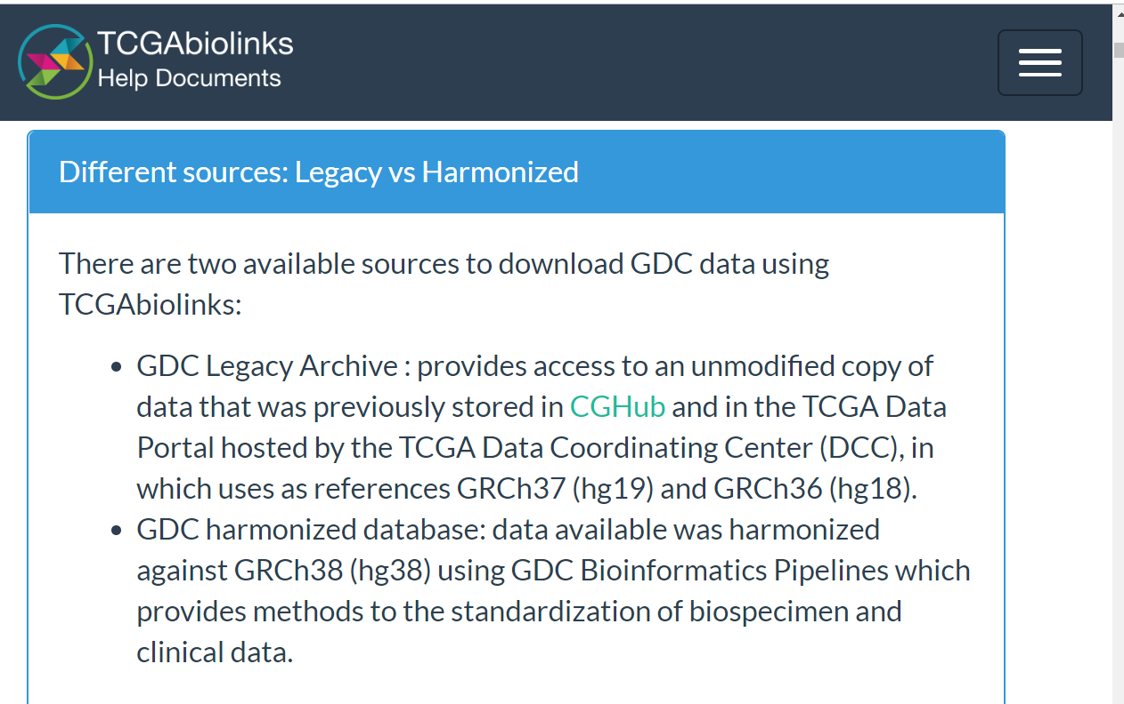
TCGA Legacy
Legacy older genomes (hg19 or hg18)
Harmonized database have standards for specimen and clinical data

Slide 24
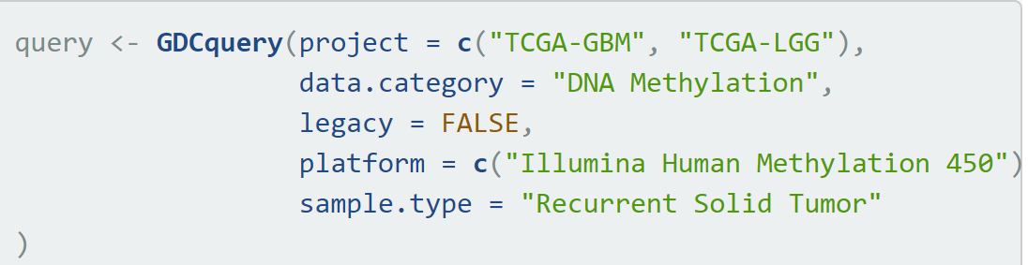
GDCquery()
This is dependent on SQL databases and can be computationally intensive

Slide 25
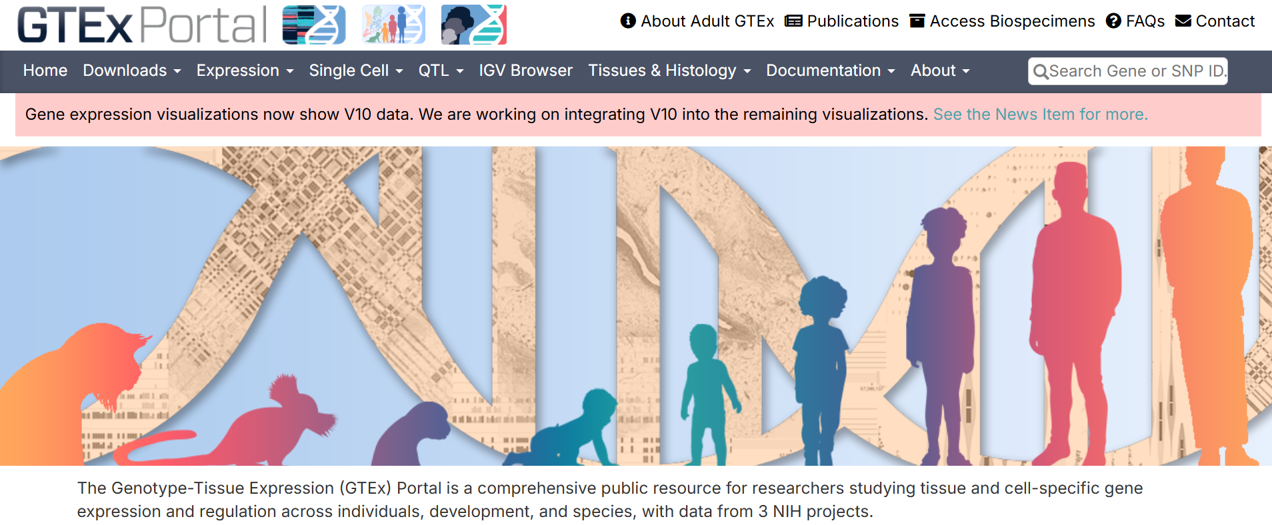
GTEx
https://gtexportal.org/home/

Slide 26
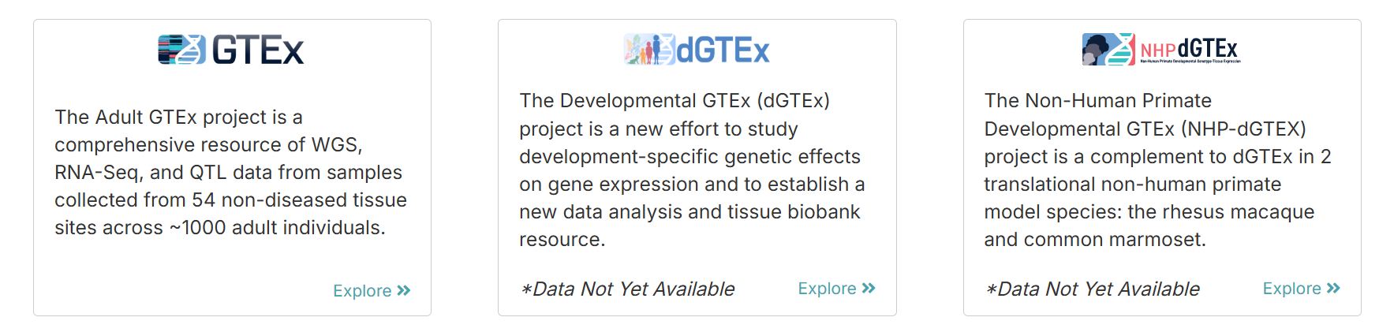

Slide 27
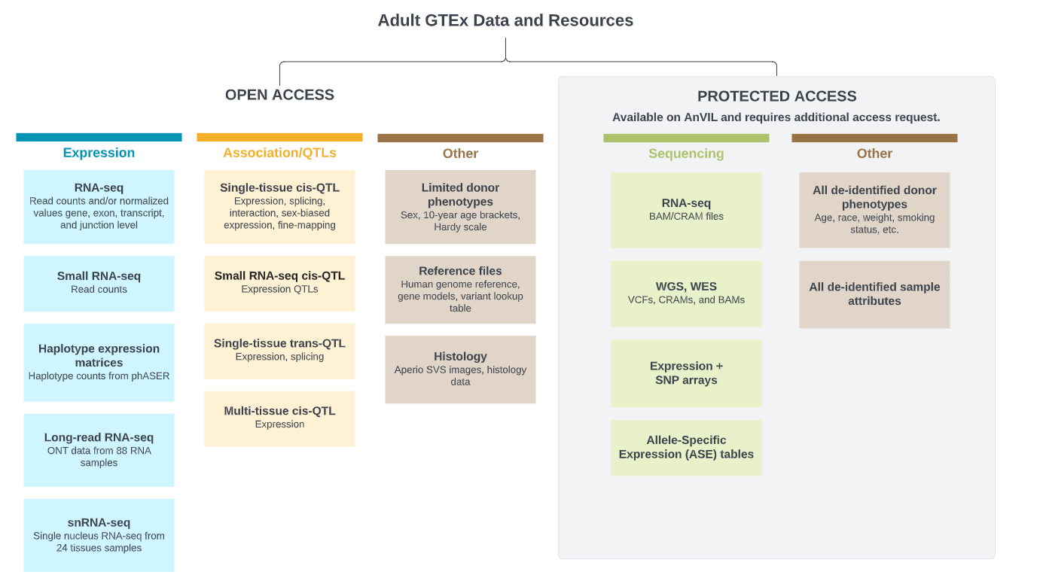

Slide 28
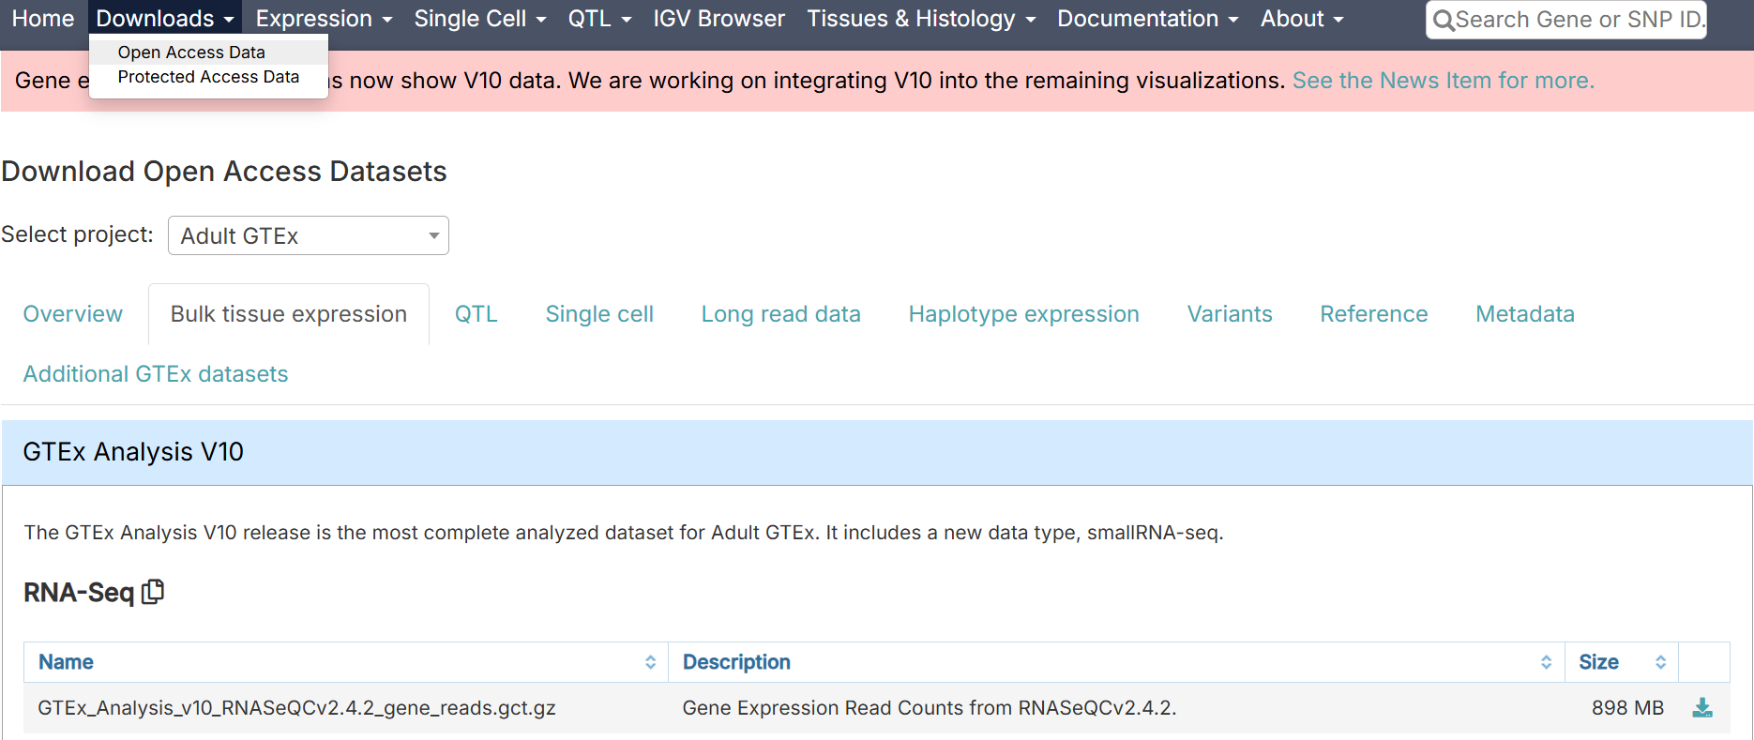

Slide 29
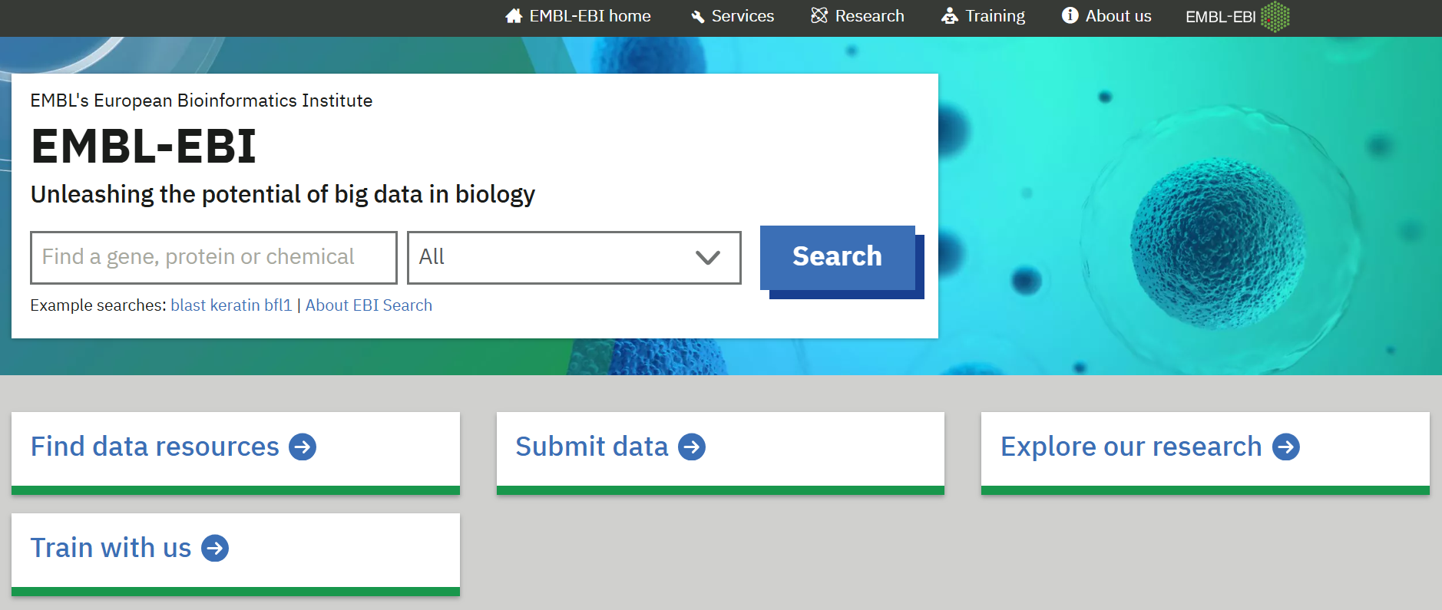
European Bioinformatics Institute
https://www.ebi.ac.uk/

Slide 30
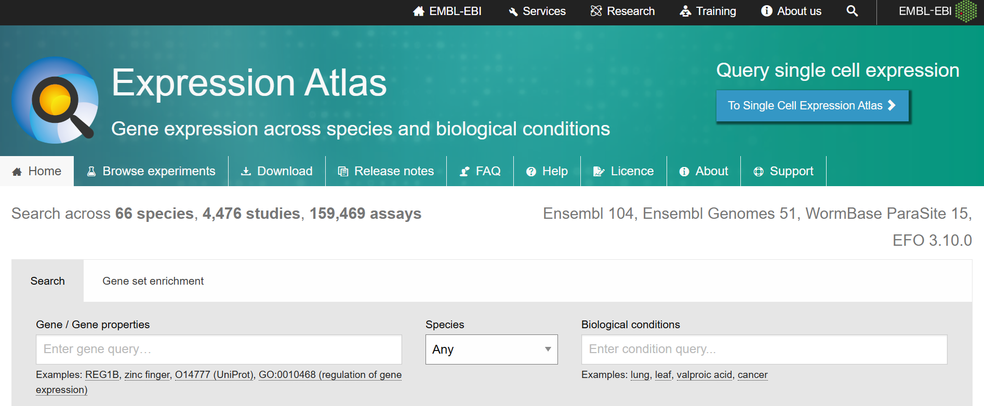
EBI Expression Atlas
https://www.ebi.ac.uk/gxa/home

Slide 31
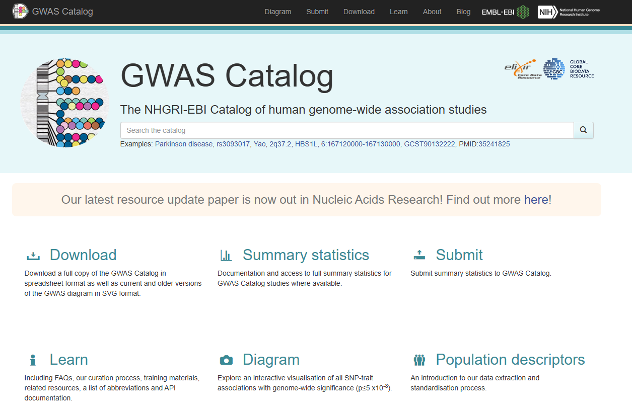
GWAS Catalog
https://www.ebi.ac.uk/gwas/

Slide 32
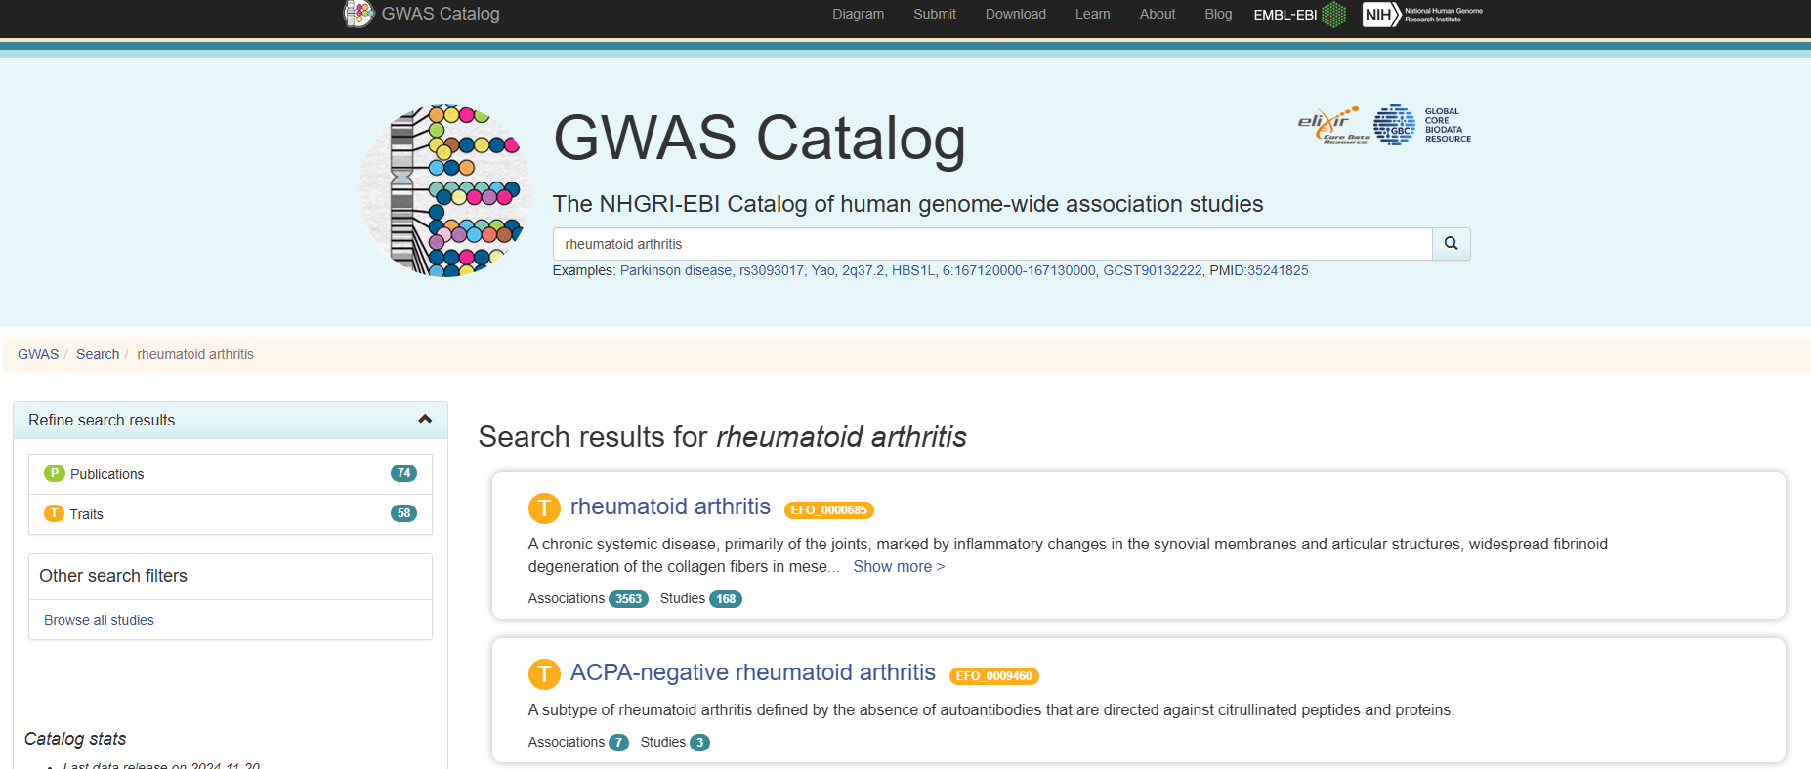

Slide 33
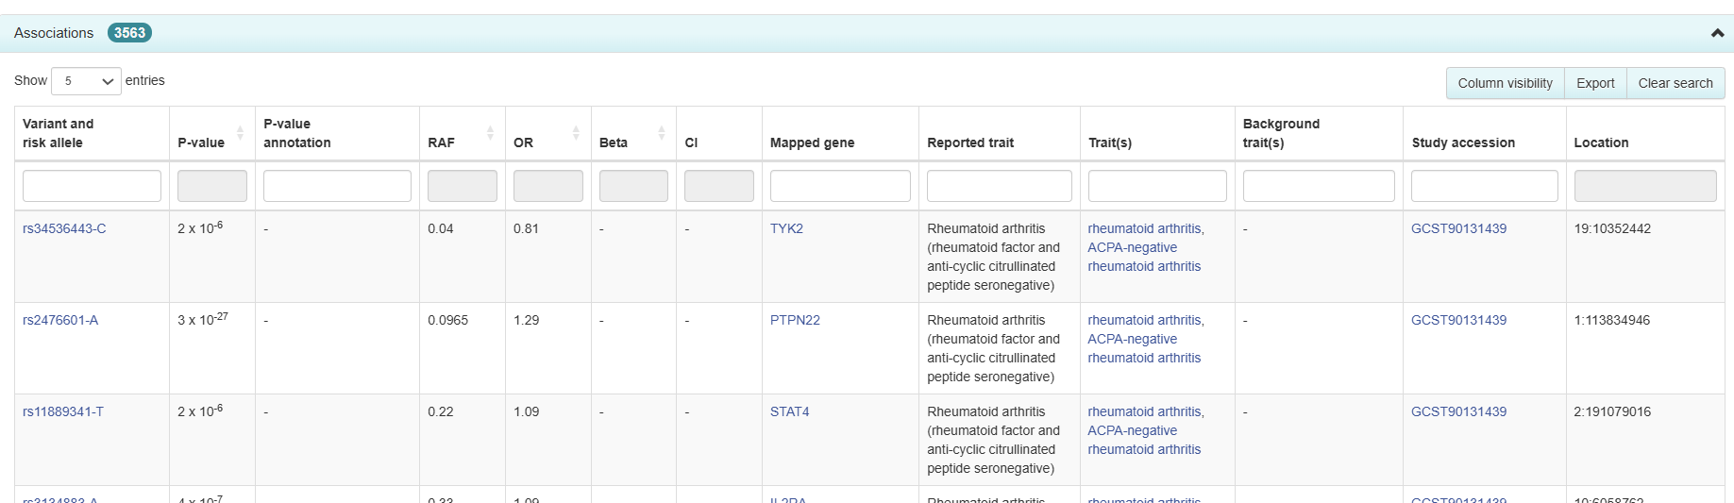
Really hard to get full genetic data due to privacy and confidentiality, but summary statistics are readily available

Slide 34
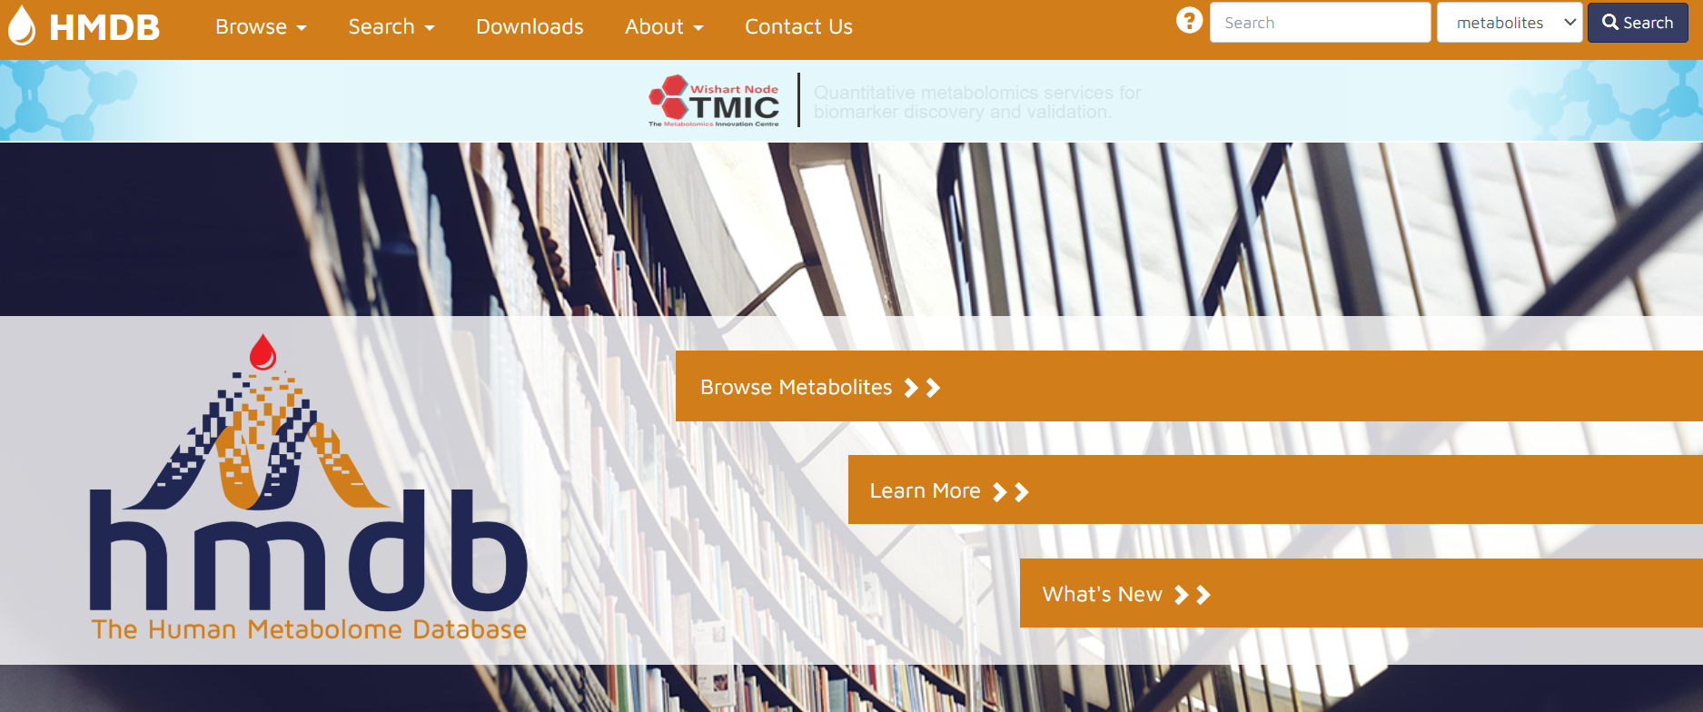
Metabolomic Datasets
https://hmdb.ca/

Slide 35
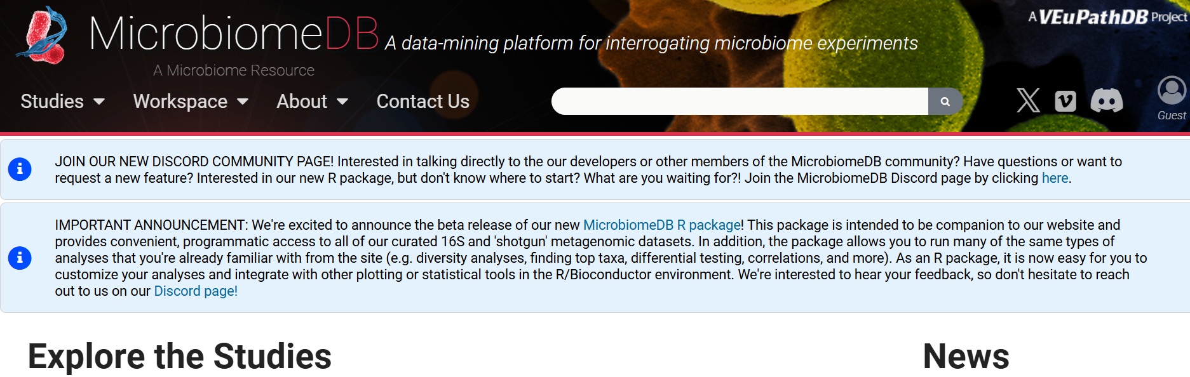
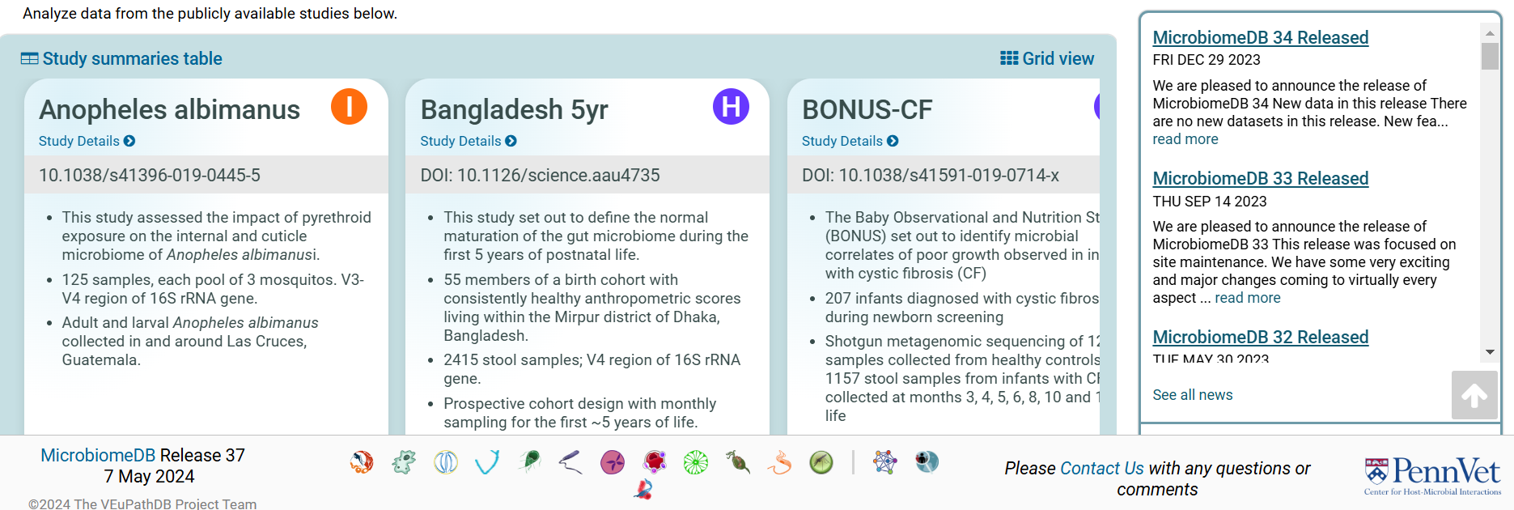
MicrobiomeDB
https://microbiomedb.org/mbio/app

Slide 36
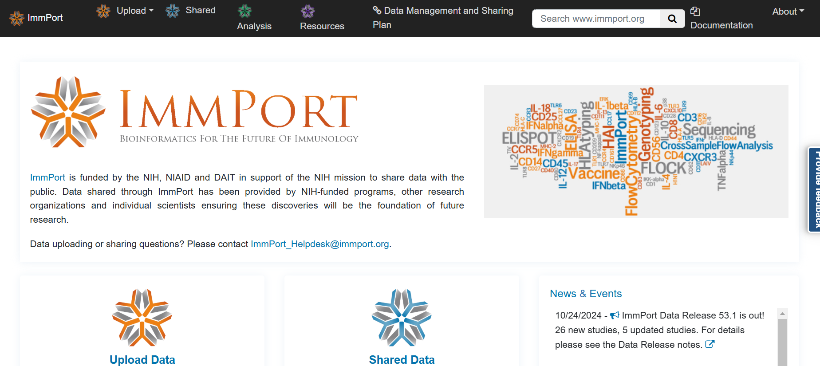
Immunology Database and Analysis Portal (ImmPort)
https://www.immport.org/home

Slide 37
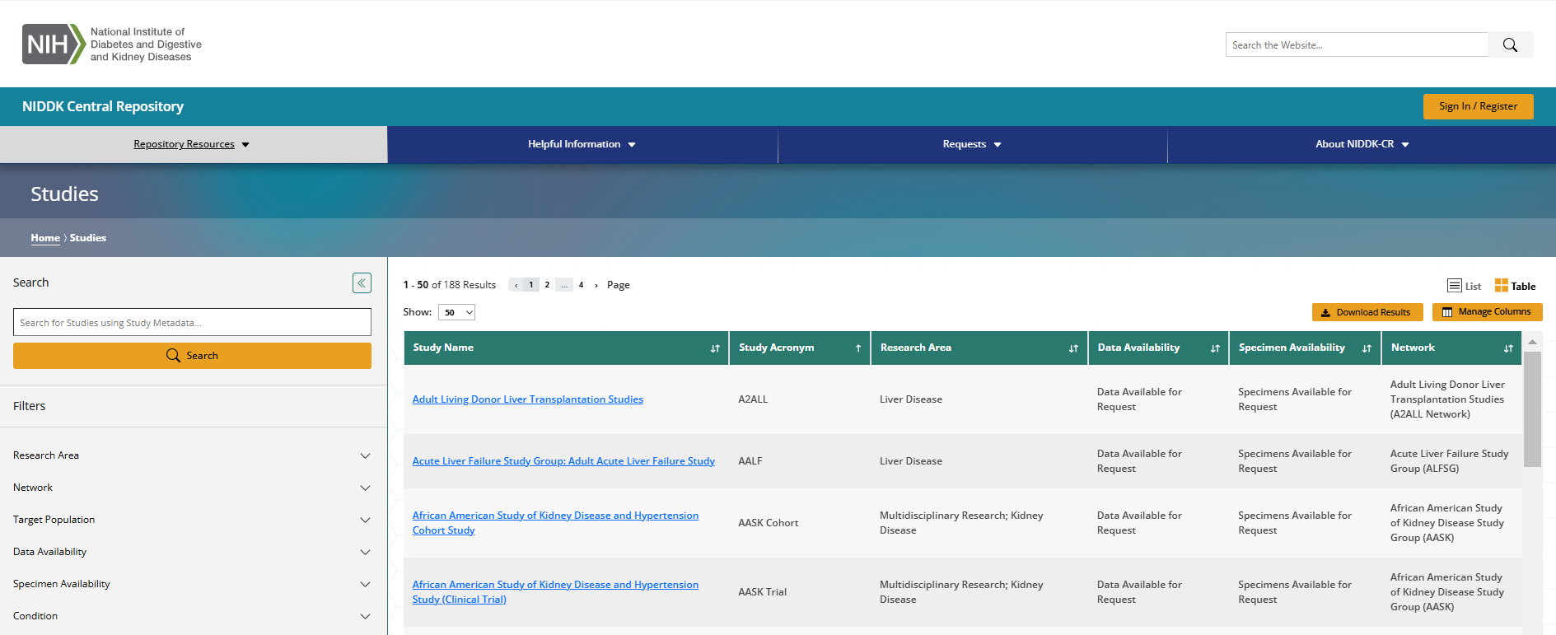
NIDDK Repository

Slide 38

Institute Specific Repositories
https://sharing.nih.gov/accessing-data/accessing-scientific-data

Slide 39
Non-human Repositories

Slide 40

Gene Network
https://genenetwork.org/
Extensive database on rodents
Group is panel or cohort. This example is a recombinant inbred panel
Type: Phenotype or Tissue Specific (Adispose)
Dataset: Specific experiment

Slide 41

Rat Genome Database
https://rgd.mcw.edu/wg/data-menu/

Slide 42
Validation Tools

Slide 43

KM Plotter
http://kmplot.com/analysis/

Slide 44

Quick Sidebar - Survival Data
Often used in clinical trials
Outcome variable is the time until the occurrence of an event of interest
Death (overall survival)
Disease specific survival (DSS)
Disease-free survival
Progression-free survival
Metastasis-free survival
Censored data
Source: alphabeta statistics

Slide 45
Kaplan-Meier survival curves
S(t) = probability of surviving (event-free) from the beginning of the study to time t
R(t) = cumulative risk of having the event from the beginning of the study to time t
Cumulative risk = 1 – cumulative survival
Kaplan-Meier method:
Nonparametric
Calculate interval-specific survival
probabilities
Generate step function (changes
value only at event times)
Compare groups with log-rank test
Clark et al (2003) Br J Cancer 89(2):232-238

Slide 46

Kaplan-Meier Curves
Visualize separation using a KM curve
For KM-plotter, can put in single gene, multiple genes (as in a gene signature)
Not very useful for multivariable analysis, and does not estimate the magnitude of the association.

Slide 47


KM Plotter – Selecting Data for Analysis

Slide 48


KM Plotter - Results

Slide 49
Data Integration

Slide 50

Multiple ‘Omics Datasets
Environment
Want to get a bigger picture on what is happening
Multiple ‘omics datasets
TF Binding Sites
Post Translational Modifications
Chromatin Remodeling
Epigenome
microbiome
Bio-chem
Pheno-types
Genome
Transcriptome
Proteome
Metabolome
Phenome

Slide 51

Source: Melgen

Slide 52

Horizontal vs Vertical Data Integration
Horizontal
Same technology
Different samples
Vertical
Different technology
Same samples

Slide 53


Integration with DNA
Most common form of data integration
DNA marker set of Single Nucleotide Polymorphisms (SNPs)
2 copies of chromosomes
Homozygous major allele (AA)
Heterozygous (AG)
Homogzygous minor allele (GG)
99.9% genome same among individuals
Easy to integrate with other ‘omics datasets tied to genome
mRNA
Proteomics
DNA methylation
Look at physically closest SNP or candidate marker
Source: Wikipedia

Slide 54
Quantitative Trait Loci (QTL) Mapping
Attempt to explain the genetic basis of variation in complex traits
Outcome is a continuous measure
Phenotype (pQTL)
Gene/Transcript Expression (eQTL)
Methylation QTL (mQTL)
Metabolite QTL (also can be referred to as mQTL, but metabQTL or metQTL)
Predictor is SNP marker
Linear modeling with the base model of outcome = SNP
SNP is most often modeled as additive (0, 1 or 2 copies of an allele)
Dominant or recessive models sometimes performed if biologically relevant

Slide 55


QTL Continued
p-values reported and plotted (Manhattan plot)
Logarithm of odds “LOD” Score:
log10 likelihood ratio comparing hypothesis of a QTL at position λ versus that of no QTL
$LOD\left(λ\right)= \log_{10}\left\{\frac{P{(y|QTL at λ)}}{P(y|no QTL)}\right\}$
This is common among animals models
Estimated at least 30% of gene transcripts are substantially influenced by eQTL (Romanoski et. al, 2010)
Example QTL for both a phenotype (systolic blood pressure, black trace) and a candidate eigengene expression (from WGCNA, blue trace). Red and blue dotted lines show the genome-wide significant and suggestive thresholds for the eQTL.

Slide 56

Cis vs Trans Regulation
Cis is genetic control from some SNP close to gene
Trans is genetic control from SNP far away from gene
You do see these eQTL “hotspots”
Source: Yao et al, 2017
missense SNP affects protein structure/function
non-coding SNP affects gene expression (cis)
non-coding SNP affects remote (trans) gene expression directly or by
cis-eGene mediation of the trans-eQTL-trans-eGene association; or
reverse causality (trait has feedback effect on gene expression).

Slide 57
Epigenetic Effects & mRNA Expression
Easy to link because of location
Have ChIP peak in a range of gene’s TSS
DNA methylation and gene expression
Same samples: correlation (expect negative correlation)
Different samples: take candidate list of say differential methylated positions and see if there are differential expression in corresponding gene
miRNA and mRNA
Find the targets for miRNA
multiMiR (Dr. Katerina Kechris)
Look at correlation or candidates (yes/no)
http://multimir.ucdenver.edu/

Slide 58
LASSO to get miRNA-mRNA network
Datasets available:
miRNA dataset (~2,000)
mRNA dataset (~20,000)
miRNA can target multiple genes
Perform WGCNA on the mRNA dataset
Identify miRNA(s) that regulate module by performing LASSO using eigengene as outcome and miRNAs as predictors
Need to have same samples in both datasets

Slide 59
R/mixOmics
Feature Selection
Data integration
Supervised analysis
Classify or discriminate sample groups
Sparse Partial Least Squares Discriminant analysis (sPLS-DA)
Original 1 dataset approach
DAIBLO
Integration of same biological samples (N) measured on different platforms
N-integration
MINT (Meta Analysis)
Integration of independent datasets on measured on same predictors
P-integration

Slide 60

Methods Available in mixOmics

Slide 61

DIABLO
Data Integration Analysis for Biomarker discovery using Latent variable approaches for ‘Omics studies
Builds on
generalized canonical correlation analysis (CCA)
Sparse sGCCA method

Slide 62

Canonical Correlation Analysis (CCA)
Multivariate correlation
Accounts for multi-collinearity
Features in a dataset not independent
Know not all genes are independent from each other
Compare sets of variables to sets of variables
Canonical loadings
Variables relationship to own set
E.g. gene A expression to gene B expression
Canonical weight
Variables relationship to other set
E.g. gene A expression to miRNA X expression
Canonical Cross-loadings
Variables relationship to other set
E.g. gene A expression to whole miRNA set CONSIDERING all of gene A’s other interaction with other genes in it’s own set
Canonical loadings and cross-loadings are called structure coefficients
Canonical weight is a function coefficient
Canonical correlation is the correlation between sets
Redundancy coefficients
Shared loading variance (variance explained within set)
Shared cross-loading variance (variance explained between sets)
Source: Rajasundaram et. Al, 2014

Slide 63
Sparse Multiple Canonical Correlation Network Analysis (SmCCNet)
R/SmCCNet
Katerina Kechris & Jenny Shi
CCA: Relationship between 2 multivariate datasets measured on same samples
E.g. Gene A to Gene B within mRNA dataset
Multiple: multiple ‘omics datasets
miRNA and mRNA
Sparse: not expecting many connections
Source: Katerina Kechris

Slide 64


CCA vs Sparse CCA
Source: Katerina Kechris

Slide 65

SmCCA
Subsampling of miRNA/mRNA & cross-validation of samples for sparse penalties on weights
Source: Katerina Kechris

Slide 66
Mediation Analyses
M
Observe a relationship between independent (X) and dependent variables (Y)
Mediator (M) is in the causal pathway of X -> Y
Complete & partial mediation
We have seen something like this!
Build on this an get Directed Acyclic Graph (DAG)
X
Y
DNA
RNA
Protein

Slide 67

Mediation Example
Bayesian networks adds the arrows between nodes of same dataset
Ideal for taking an event that occurred and predicting the likelihood that any one of several possible known causes was the contributing factor
Computationally intensive
Once again, start small and build up
Source: Rudra et. al, 2018

Slide 68

Integration with Machine Learning
PrediXcan Overview
https://github.com/hakyimlab/MetaXcan
Your Studies Genetic Data
GTEX Tissue Specific eQTL
Predicted Gene Expression
TWAS

Slide 69
Other Integration Software
R/Omic
R/integrOmics
R/ STATegRasPLS
R/OMICsPCA
R/MultiAssayExperiment
R/iCluster
R/CNAmet
R/OmicKriging
matlab/JIVE
JAVA/OmicsAnalyzer
JAVA/VANTED
JAVA/Lemon-Tree
C++/DASS-GUI
C++/GeneTrail2
Perl/3Omics
Perl and Python/PaintOmics

Slide 70
Conclusions

Slide 71
What did we learn?
Many public repositories where we can download data
Lots of them have R/packages and APIs to easily download data
Genetic data is generally available only as summary statistics
‘Omics data integration is either horizontal or vertical
Multiple ways to integrate data types

